Slide 1
Biology
Sylvia S. Mader
Michael Windelspecht
Chapter 23
Plant Evolution and Diversity
Lecture Outline
See separate FlexArt PowerPoint slides for all figures and tables pre-inserted into PowerPoint without notes.
Textbook: p. 407 Chapter 23 outline
Copyright 2022 © McGraw Hill LLC. All rights reserved. No reproduction or distribution without the prior written consent of McGraw Hill LLC.

Slide 2
Outline
23.1 Ancestry and Features of Land Plants
23.2 Evolution of Bryophytes: Colonization of Land
23.3 Evolution of Lycophytes: Vascular Tissue
23.4 Evolution of Pteridophytes: Megaphylls
23.5 Evolution of Seed Plants: Full Adaptation to Land
Textbook: p. 408 Section 23.1 start | p. 411 Section 23.2 start | p. 413 Section 23.3 start | p. 415 Section 23.4 start | p. 418 Section 23.5 start

Slide 3
23.1 Ancestry and Features of Land Plants
Plants are multicellular, photosynthetic eukaryotes
Plant systematists use molecular and morphological information to classify plants
  Plants are thought to have evolved from a freshwater green algae about 590 MYA
  Like plants, green algae
    Contain chlorophylls and accessory pigments
    Store excess carbohydrates as starch
    Have cellulose in their cell walls
  Difference between plants and algae: besides protecting the zygote, plants also protect and nourish the embryo
Textbook: p. 408 Plants: definition & classification | p. 408 Green algae vs. plants; embryo | p. 427 Chapter summary 23.1 (590 mya)

Slide 4
Characteristics of Plants
Table 23.1 Characteristics of Plants
DOMAIN: Eukarya SUPERGROUP: Archaeplastida KINGDOM Plantae
CHARACTERISTICS Multicellular; apical tissue produces specialtzed tissues altemations-of- generation life cycle: protection of the embryo: gametangla produces gametes waxy cuticle prevents water loss
Nonvascular Plants The Bryophytes Liverworts, hornworts, and mosses are low lying and live in moist environments. Dominant gametophyte produces flagellated sperm unbranched, dependent sporophyte produces windblown spores.
Seedless Vascular Plants - The Lycophytes and Pteridophytes Dominate branched sporophyte has vascular tissue: Lignified xylem transports water, and phloem transports organic nutrients: typically has roots, stems and leaves sporangia borne on sides of leaves that produce windblown spores Independent and separate gametophyte produces flagellated sperm. Lycophyte leaves are microphylls with a single, unbranched vein. Pteridophyte leaves are megaphylls with branched veins.
Seeded Vascular Plants–The Gymnosperms and Angiosperms Leaves are megaphylls: dominant sporophyte produces heterosperes that become dependent male and female gametophytes Male gametophyte is pollen grain, and female gametophyte occurs within ovule, which becomes a seed. Gymnosperms are cone bearing: sporophyte bears pollen cones. which produce windtown pollen (male gametopyte, and seed cones which produce seeds Angiosperm sporophytes bear flowers, which produce pollen grain and beat vules within an ovary Following double fertilization, ovules become seeds that enclose a sporophyte embryo and endosperm. Fruit develops from ovary
Table summarizes characteristics of plants including Eukarya, supergroup: Archaeplastida and kingdom: Plantae.
Textbook: p. 408 Table 23.1

Slide 5
The Ancestry of Land Plants
Land plants are most closely related to freshwater green algae known as charophytes
  Charophytes and land plants are in the same clade
    Ancestors of land plants were most closely related to the charophytes Chara and Coleochaete
      Most important to the evolution of plants, charophytes protect the zygote
Textbook: p. 408 Charophytes

Slide 6
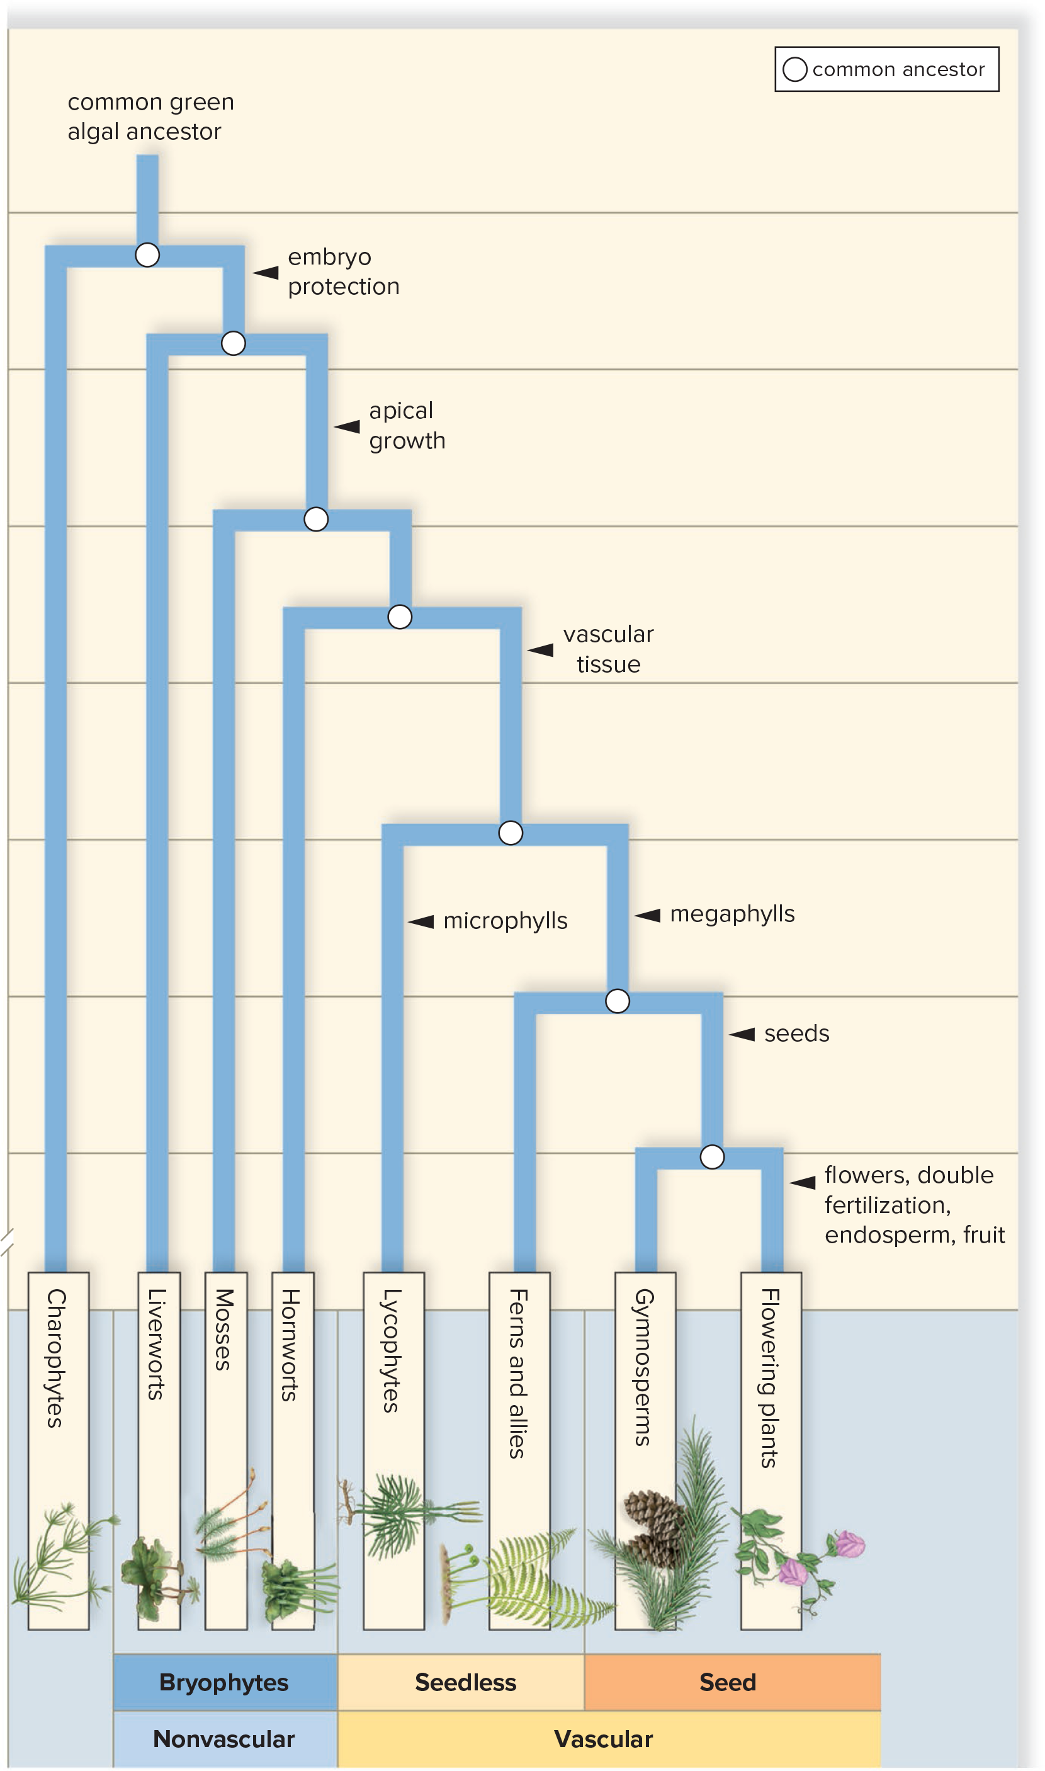
Evolutionary History of Plants
Figure 23.1
Access the text alternative for slide images.
Textbook: p. 409 Figure 23.1 | p. 408 Order in which plant groups arose

Slide 7
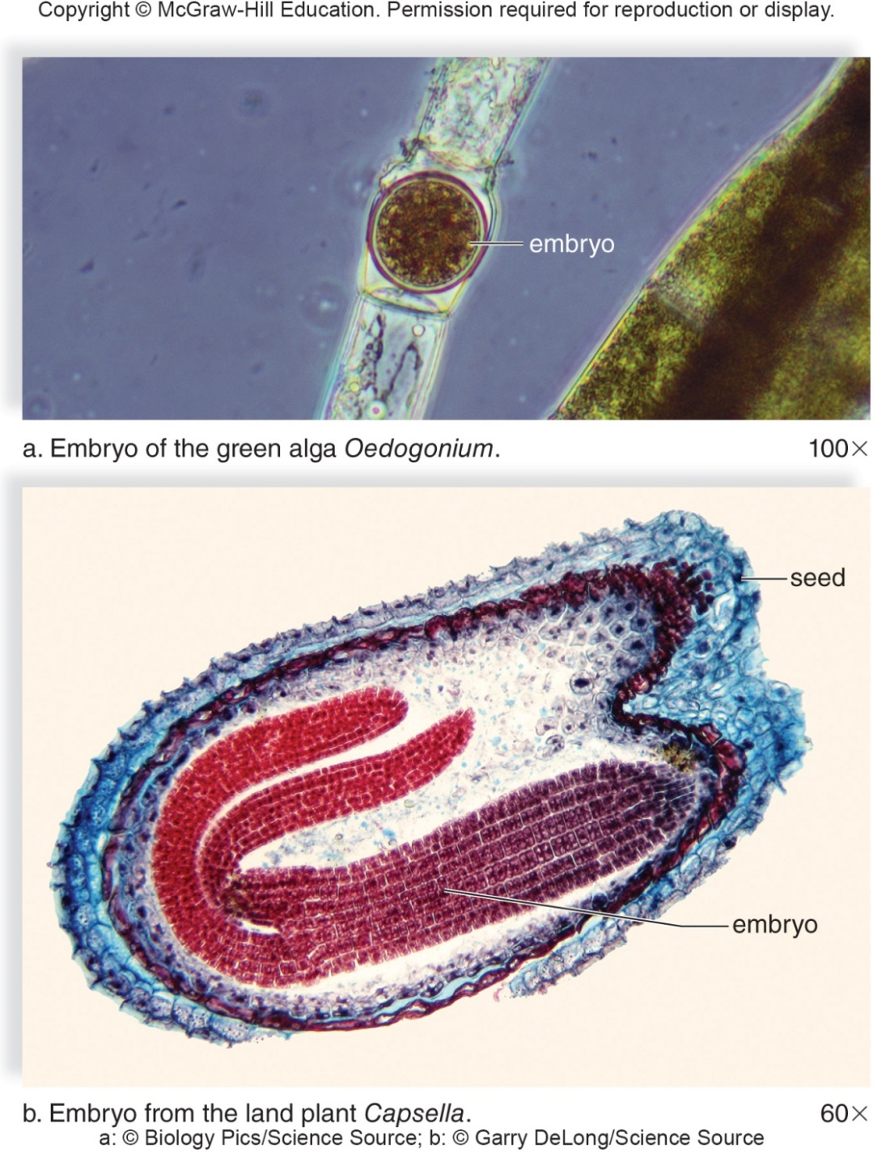
Embryo Difference in Green Algae and Land Plants
Figure 23.2
Access the text alternative for slide images.
(a): Biology Pics/Science Source; (b): Garry DeLong/Science Source
Textbook: p. 410 Figure 23.2 | p. 408 Green algae vs. plants; embryo

Slide 8
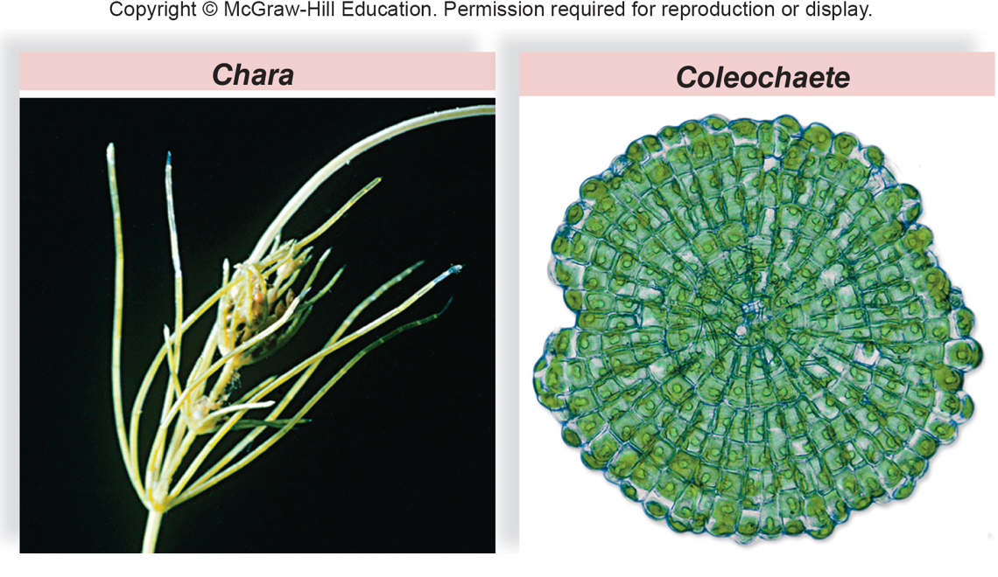
Charophytes
Figure 23.3
Textbook: p. 410 Figure 23.3 | p. 408 Charophytes

Slide 9
Adaptation to Land
Being on land required plants to evolve mechanisms to minimize dehydration, move water and nutrients against gravity, and damage from UV radiation:
  Waxy covering called a cuticle protects most land plants from desiccation
    Cuticle covers exposed surfaces and is relatively impermeable
    Small openings, called stomata, are found mostly on the underside of leaves and allow for gas exchange between the plant and the environment
  To move water against the force of water many plants have tracheids, specialized cells with proteins that resist gravity and facilitate the upward transport of water and minerals
Textbook: pp. 408-409 Adaptation to land: cuticle, stomata, tracheids

Slide 10
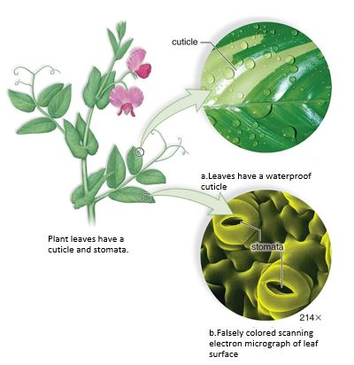
Leaf Adaptation to Prevent Desiccation
Figure 23.4
Access the text alternative for slide images.
Textbook: p. 410 Figure 23.4 | pp. 408-409 Adaptation to land: cuticle, stomata, tracheids
(a): Ingram Publishing/age fotostock RF; (b): Dr Jeremy Burgess/Science Source

Slide 11
Land Plants
    Land plants have tissues which reduces water loss to the environment because they have a lower surface-area-to-volume ratio than do branched filaments
    To reduce the effects of UV radiation, plants have both a haploid and diploid generation
      Diploid generation helps to hide the effect of a single deleterious allele
      Evolutionary shift toward a more dominant diploid generation also allows for greater genetic variability in land plants
Textbook: p. 409 Tissues & UV / diploid generation

Slide 12
Alternation of Generations
All land plants exhibit alternation of generations:
  Plant alternates between a multicellular haploid (n) phase and a multicellular diploid (2n) phase
    Multicellular haploid individuals are called gametophytes
    Gametophytes produce gametes (eggs and sperm) by mitosis within tissue called gametangia
      Male gametangia are called antheridia
      Female gametangia are called archegonia
      Eggs and sperm combine to form diploid sporophytes
    Multicellular diploid individuals are called sporophytes
      Sporophytes produce spores by meiosis within a structure called the sporangium
      Spores are released and if they land on suitable substrate, germinate and grow by mitosis into gametophytes
Textbook: p. 409 Alternation of generations

Slide 13
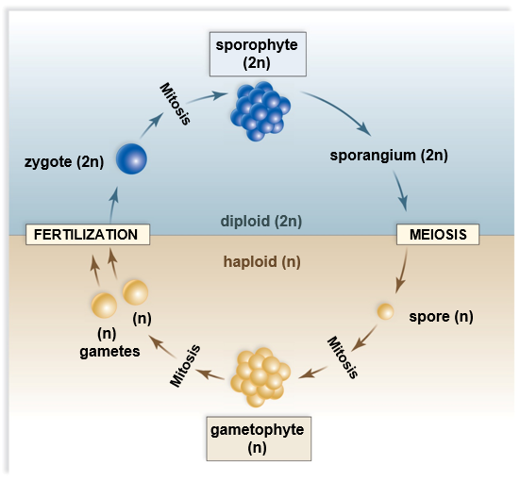
Alternation of Generations in Land Plants
Figure 23.5
Access the text alternative for slide images.
Textbook: p. 410 Figure 23.5 | p. 409 Alternation of generations

Slide 14
Dominant Generation
Land plants differ as to which generation is dominant (conspicuous)
  In early land plants like moss, the gametophyte is dominant
  In all other plants such as ferns, pine trees, and flowering plants, the sporophyte is dominant
      Shift to sporophyte dominance is adaptation to land
        Only sporophytes have vascular systems
        As the sporophyte becomes dominant, the gametophyte becomes reduced in size and dependent on sporophyte
Textbook: pp. 409-410 Dominant generation

Slide 15
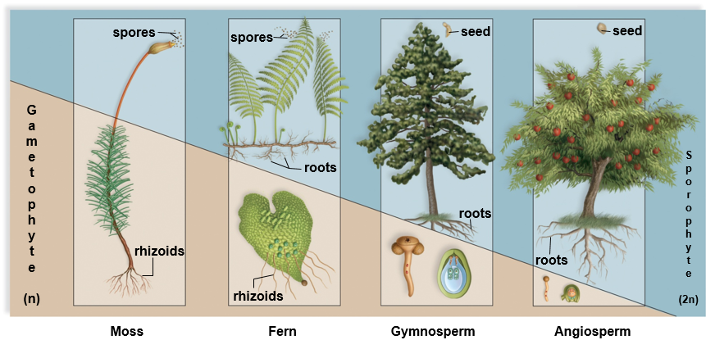
Reduction in the Size of the Gametophyte
Figure 23.6
Access the text alternative for slide images.
Textbook: p. 411 Figure 23.6 | pp. 409-410 Dominant generation

Slide 16
23.2 Evolution of Bryophytes: Colonization of Land
Nonvascular plants
  First plants to colonize land
    Absence of vascular tissue results in low-lying plants that
      Lack specialized means of transporting water and organic nutrients
      Do not have true roots, stems, and leaves
  Gametophyte dominant generation
    Produces eggs in archegonia
    Produces flagellated sperm in antheridia
    Sperm swim to egg in film of water
Textbook: p. 411 Bryophytes: first land plants, nonvascular | p. 411 Bryophyte traits & moist habitats

Slide 17
Liverworts
Liverwort gametophytes (n) are divided into two groups:
  Thallose liverworts: have a flattened body known as a thallus
  Leafy liverworts: superficially resemble mosses
Some liverworts like Marchantia contain rhizoids
  Hairy extensions that anchor plant in soil and aid in absorption
Liverworts can reproduce either sexually or asexually
  Gemmae are groups of cells that detach from the thallus and start a new plant (asexual)
  Sexual reproduction depends on two types of stalks bearing either antheridia (n) or archegonia (n)
    Sporophyte (2n) grows from a fertilized egg within the archegonia
    Sporophyte grows a capsule which produces and releases spores (n)
Textbook: p. 411 Liverworts: thallose vs. leafy | pp. 411-412 Marchantia: rhizoids, gemmae, reproduction

Slide 18
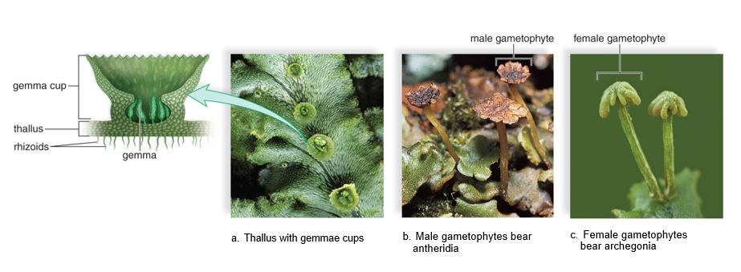
Liverwort, Marchantia
Figure 23.7
Access the text alternative for slide images.
Textbook: p. 412 Figure 23.7 | pp. 411-412 Marchantia: rhizoids, gemmae, reproduction
(a): Ed Reschke/Getty Images; (b): J. M. Conrarder/Science Source; (c): Ed Reschke/Stone/Getty Images

Slide 19
Hornworts
    Have small sporophytes rising out of thin gametophytes that carry on photosynthesis
    Sporophyte has one chloroplast per cell
    Most live in moist, well-shaded areas.
    Symbiotic relationship with cyanobacteria allow nitrogen fixation from the air
    Can bypass alternation of generations by reproducing asexually through fragmentation
Textbook: p. 412 Hornworts

Slide 20
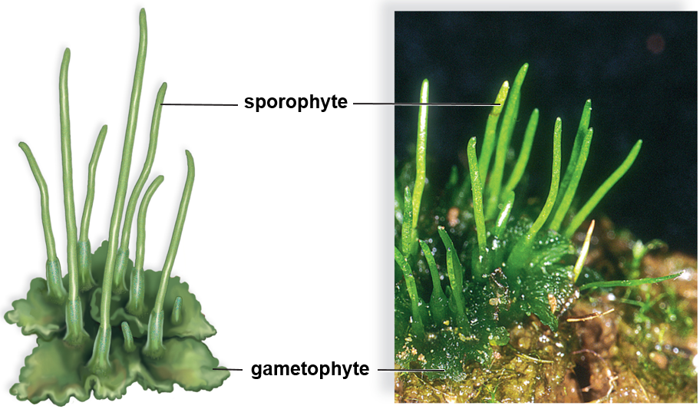
Hornwort, Anthoceros sp.
Figure 23.8
(photo): Steven P. Lynch
Textbook: p. 412 Figure 23.8 | p. 412 Hornworts

Slide 21
Mosses
  Largest phyla of nonvascular plants
  Mostly found in moist environments
  In dry environments they may become shriveled, turn brown, and look dead but when it rains they resume metabolic activity and turn green
  Three distinct groupings of mosses:
    Peat mosses, granite mosses, true mosses
      Peat moss has great commercial and ecological importance to humans
        Used to improve the water-capacity of soil
        Was used as wound dressing on battlefields
Textbook: p. 412 Mosses: groups & habitats | p. 412 Peat moss (Sphagnum) | p. 407 The Uses of Mosses (opener)

Slide 22
Life Cycle of Moss
Gametophyte (n) of a moss is called the protonema
  Precedes and produces upright, leafy shoots that sprout rhizoids
  Shoots bear either antheridia (sperm-producing) or archegonia (egg-producing)
  Sporophyte is enclosed in female gametophyte tissue
  Sporophyte has three parts:
    A foot, a stalk, and an upper capsule
      Capsule contains the sporangium, where spores are produced
      Moss sporophyte is always attached to the gametophyte
Textbook: p. 412 Moss life cycle (text)
Textbook: the protonema is the first stage of the gametophyte, not the whole gametophyte.

Slide 23
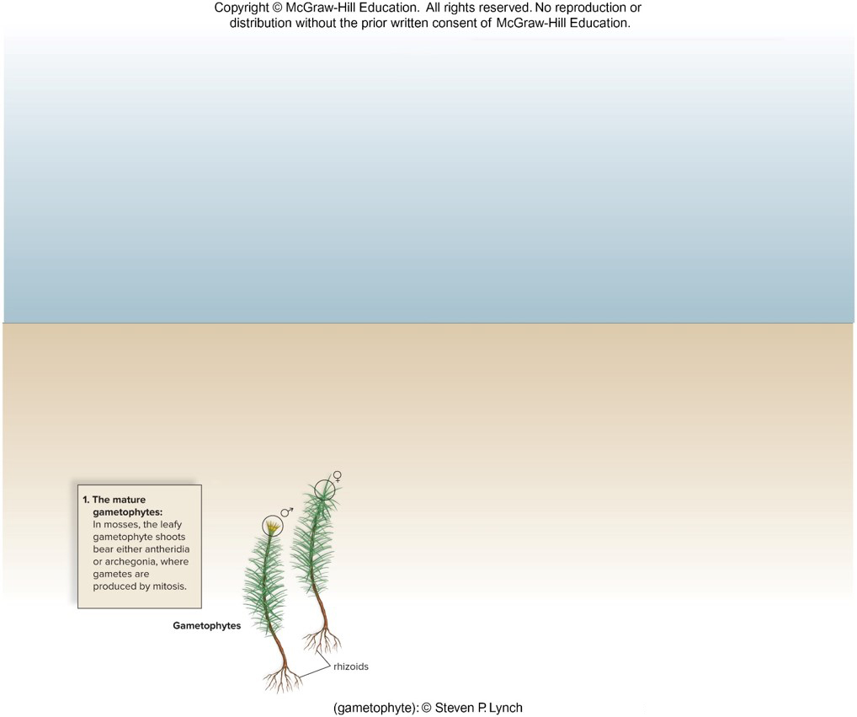
Moss Life Cycle 1
Figure 23.9
Textbook: p. 413 Fig. 23.9 step 1 | p. 413 Figure 23.9
(gametophyte):© Steven P. Lynch

Slide 24
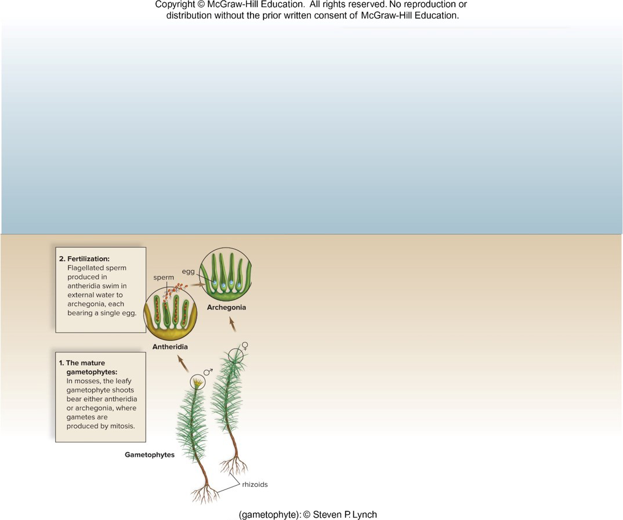
Moss Life Cycle 2
Figure 23.9
Textbook: p. 413 Fig. 23.9 step 2 | p. 413 Figure 23.9
(gametophyte):© Steven P. Lynch

Slide 25
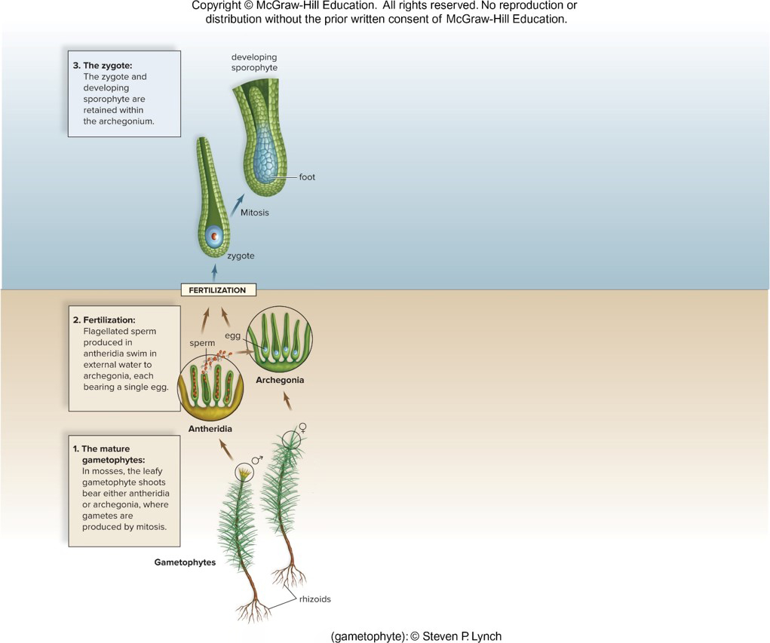
Moss Life Cycle 3
Figure 23.9
Textbook: p. 413 Fig. 23.9 step 3 | p. 413 Figure 23.9
(gametophyte):© Steven P. Lynch

Slide 26
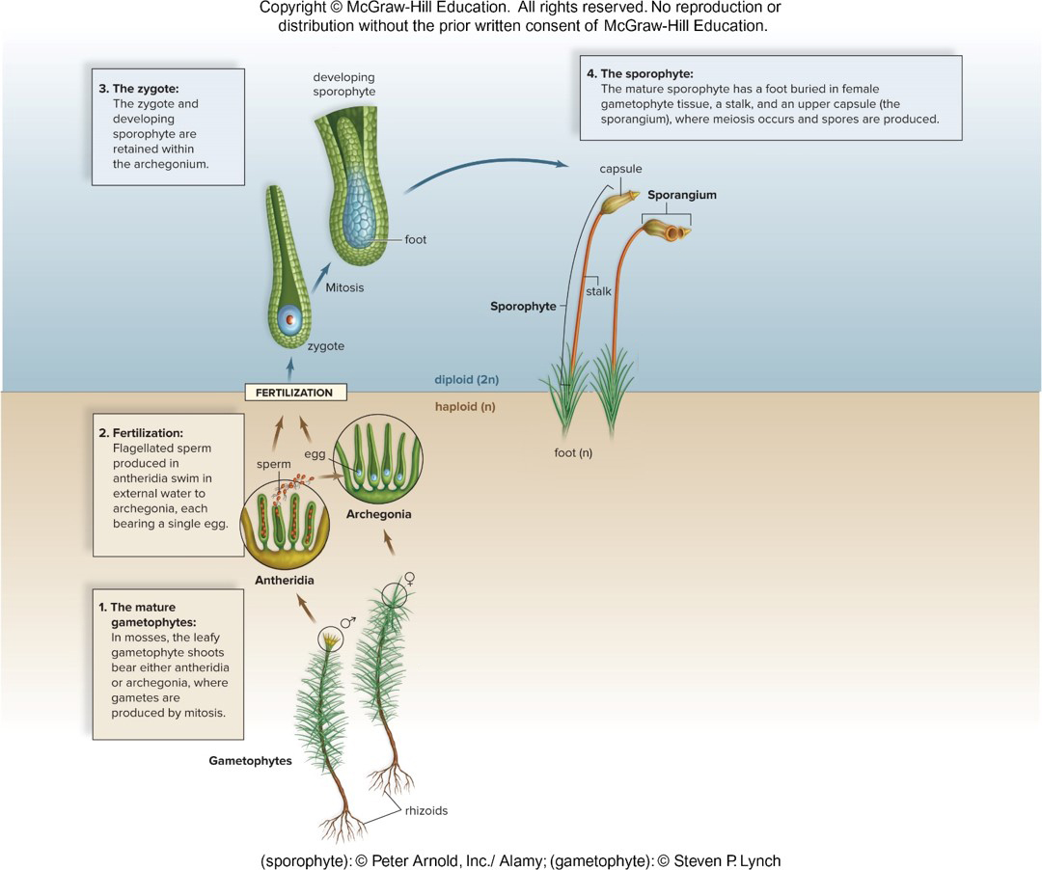
Moss Life Cycle 4
Figure 23.9
Access the text alternative for slide images.
(gametophyte):© Steven P. Lynch
Textbook: p. 413 Fig. 23.9 step 4 | p. 413 Figure 23.9

Slide 27
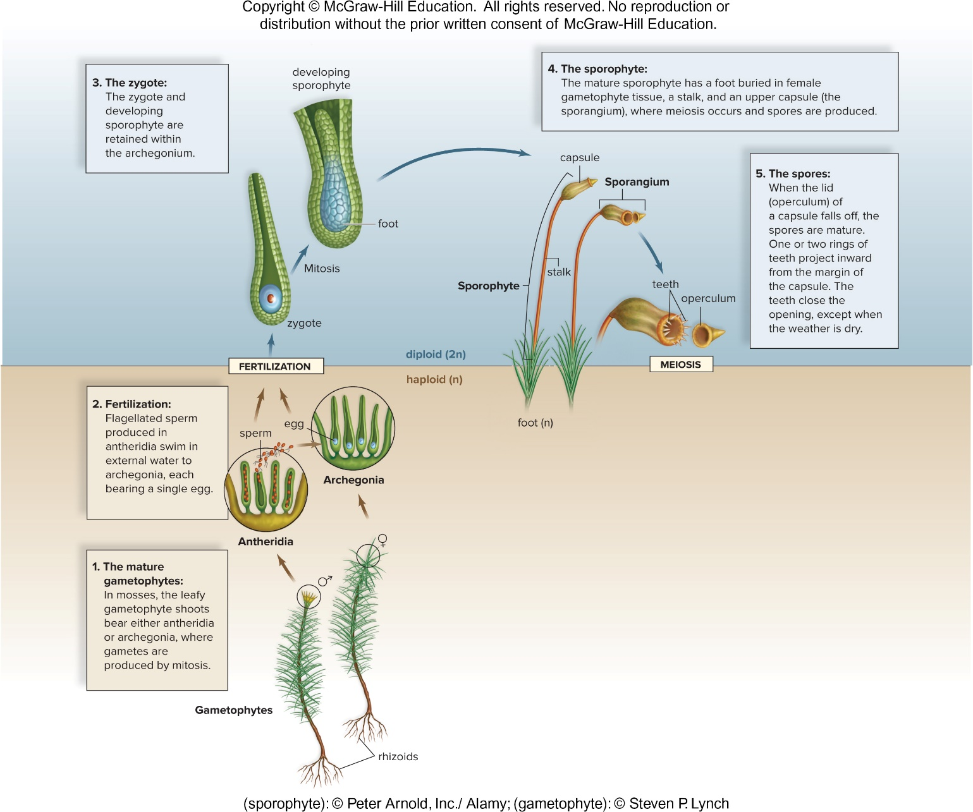
Moss Life Cycle 5
Figure 23.9
Access the text alternative for slide images.
(gametophyte):© Steven P. Lynch
Textbook: p. 413 Fig. 23.9 step 5 | p. 413 Figure 23.9

Slide 28
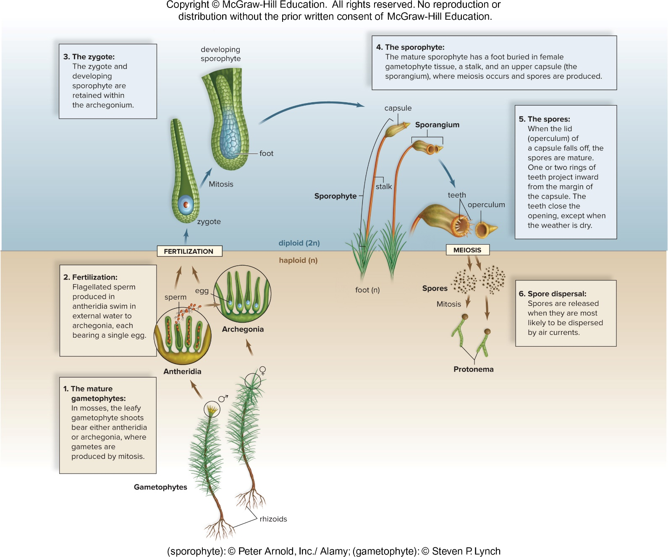
Moss Life Cycle 6
Figure 23.9
Textbook: p. 413 Fig. 23.9 step 6 | p. 413 Figure 23.9
(gametophyte):© Steven P. Lynch

Slide 29
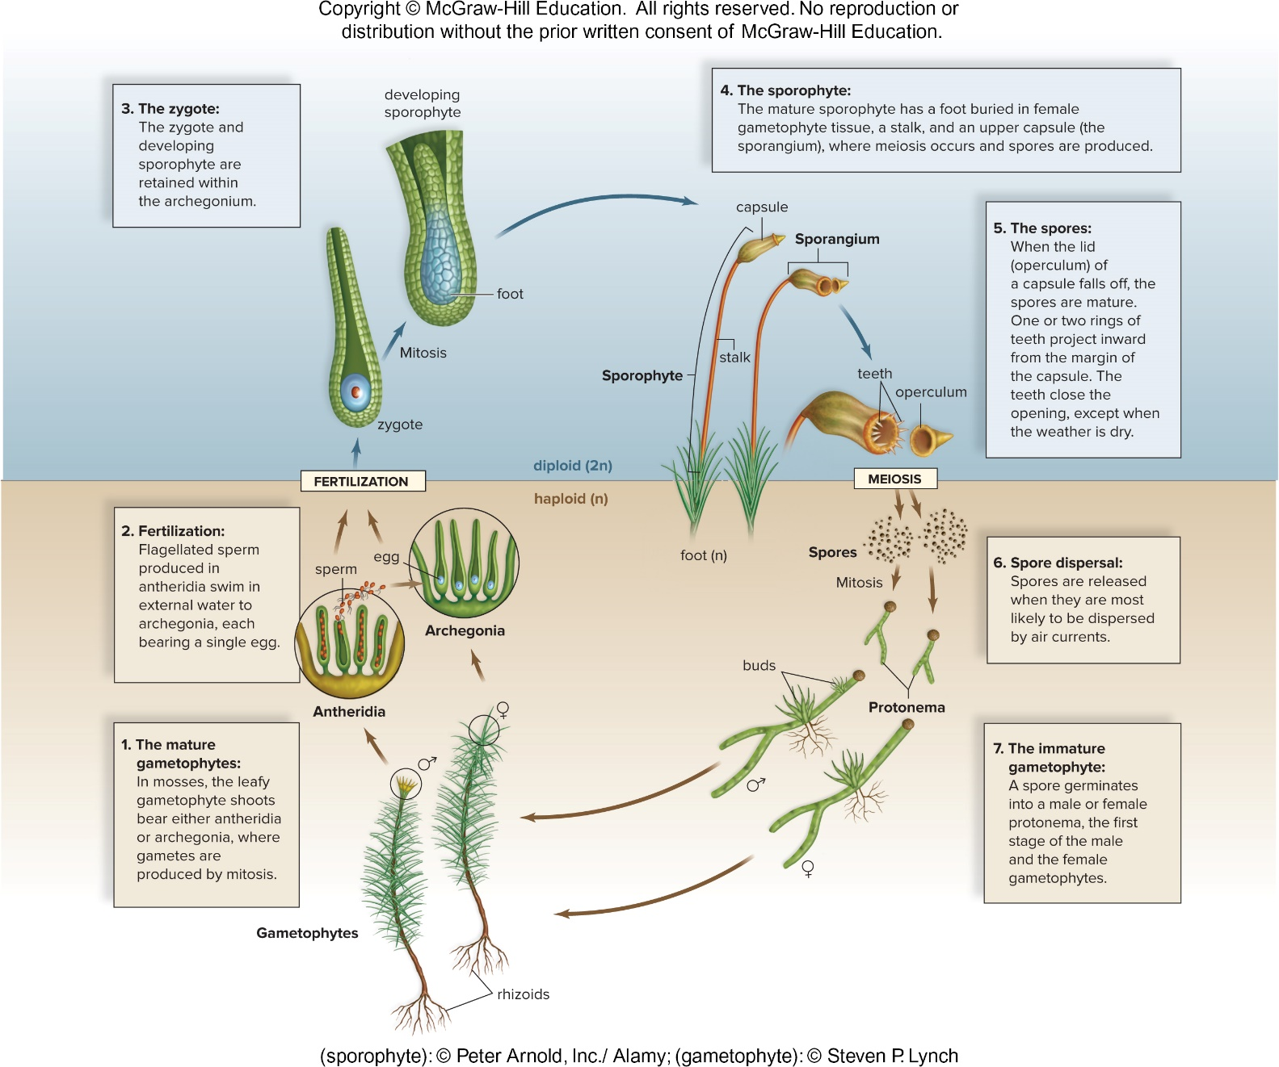
Moss Life Cycle 7
Figure 23.9
Textbook: p. 413 Fig. 23.9 step 7 | p. 413 Figure 23.9
(gametophyte):© Steven P. Lynch

Slide 30
Moss Life Cycle 8
Figure 23.9
Access the text alternative for slide images.
Textbook: p. 413 Figure 23.9 | p. 412 Moss life cycle (text)
(sporophyte): © Peter Arnold, Inc./Alamy: (gametophyte): © Steven P. Lynch

Slide 31
23.3 Evolution of Lycophytes: Vascular Tissue
Vascular plants (tracheophytes) dominate the natural terrestrial landscape
  Can achieve great heights because of roots and vascular tissue and nutrient-conducting tissue:
    Xylem conducts water and dissolved minerals up from roots
      Lignin strengthens cell walls of conducting cells in xylem
    Phloem conducts sucrose and other organic compounds throughout the plant
Textbook: p. 413 Vascular plants: xylem, phloem, lignin

Slide 32
The Origin of Vascular Plants
Fossil record indicates that the first vascular plants, such as Cooksonia, were more likely bushes than trees
  Branching of Cooksonia was significant for two reasons:
    More sporangia were produced, and therefore many more spores
    Indicative of vascular tissue
  Sporangia of Cooksonia produced windblown spores
    This classifies it (and other lycophytes and pteridophytes) as seedless vascular plants
  Lycophytes and all other vascular plants have a dominant sporophyte generation
Textbook: p. 414 Origin of vascular plants (Cooksonia)

Slide 33
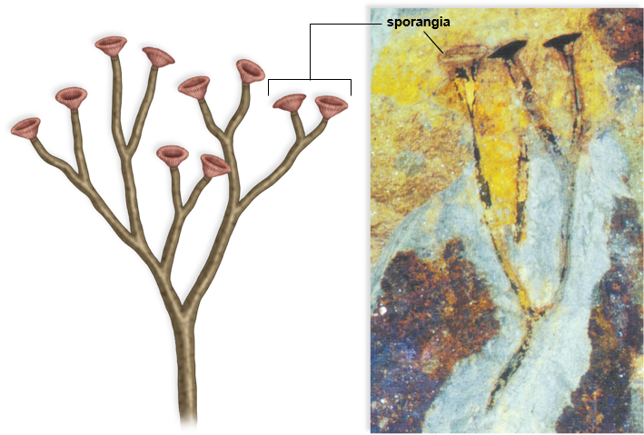
A Cooksonia Fossil
Figure 23.10
(photo): Hans Steur, the Netherlands
Textbook: p. 414 Figure 23.10 | p. 414 Origin of vascular plants (Cooksonia)

Slide 34
Lycophytes
    Roots evolved as lower extensions of the stem
    Leaves are microphylls
      Have only one strand of vascular tissue
      Most likely evolved as simple side extensions of the stem
    Cone-shaped structure called a strobili produce spores by meiosis
    Some lycophytes have spores that grow into one type of gamete (homosporous), others produce two types of spores (heterosporous)
    Microspores (become male gametophyte) and megaspores (become female gametophyte)
  Three main groups of lycophytes:
      Ground pines (Lycopodium), spike mosses (Selaginella), and quillworts (Isoetes)
Textbook: pp. 414-415 Lycophytes

Slide 35
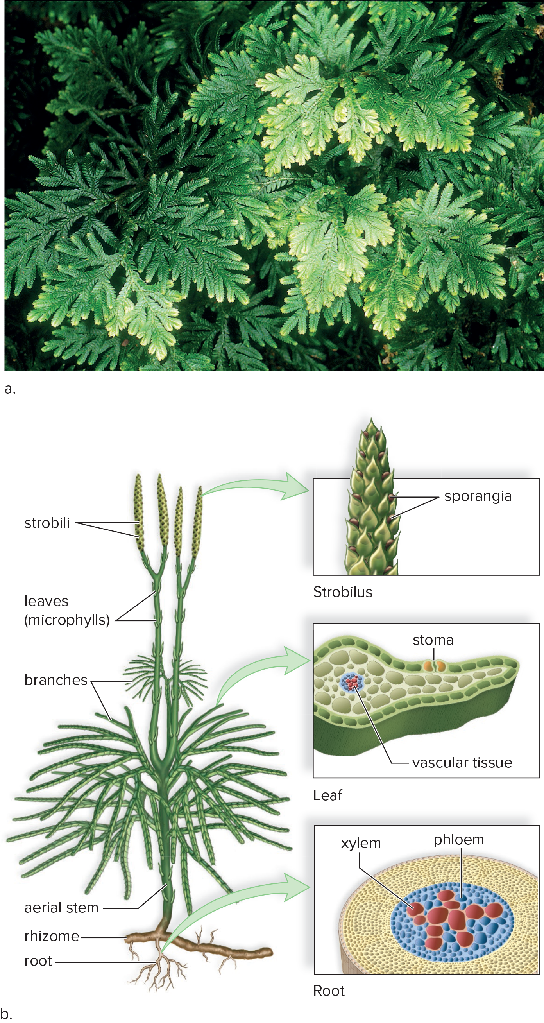
Lycophytes Example
Figure 23.11
Access the text alternative for slide images.
(a): Steven P. Lynch
Textbook: p. 414 Figure 23.11 | pp. 414-415 Lycophytes

Slide 36
23.4 Evolution of Pteridophytes: Megaphylls
Pteridophytes are seedless vascular plants
    Dominant from late Devonian through Carboniferous period
    Include ferns and their allies (horsetails and whisk ferns)
    Have megaphylls (broad leaves with several strands of vascular tissue)
      Allow plants to efficiently collect solar energy, allowing the production of more food and possibly more offspring
        Resulted in increased fitness for plants
Textbook: p. 415 Pteridophytes & megaphylls

Slide 37
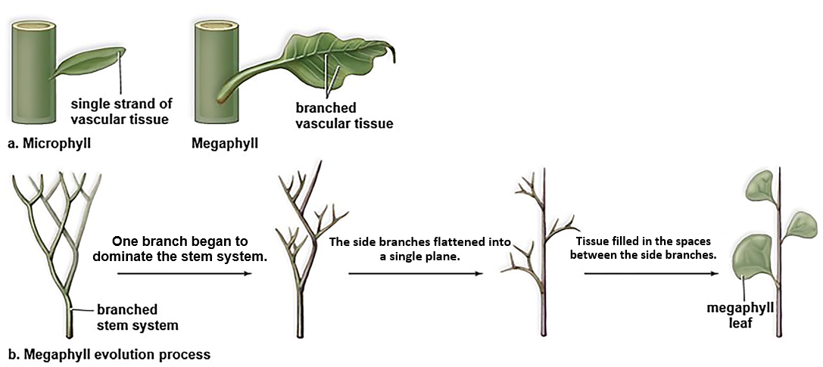
Microphylls and Megaphylls
Figure 23.12
Access the text alternative for slide images.
Textbook: p. 415 Figure 23.12 | p. 415 Pteridophytes & megaphylls

Slide 38
Horsetails
Horsetails consist of one genus, Equisetum, and approximately 15 species of seedless vascular plants
  Most horsetails inhabit wet, marshy environments
  Equisetum can be branched or unbranched, with leaves that may have been megaphylls at one time but now are reduced and form whorls at the nodes
  Branches bear resemblance to a horse’s tail
  Many have strobili at the tips of stems
  Spores germinate into inconspicuous and independent gametophytes
  Equisetum spores are sensitive to humidity and are “spring-loaded”
    Spores have been known to be ejected and travel upward of 2 mph
  Stems are tough and rigid because of silica deposited in cell walls
Textbook: pp. 415-416 Horsetails

Slide 39
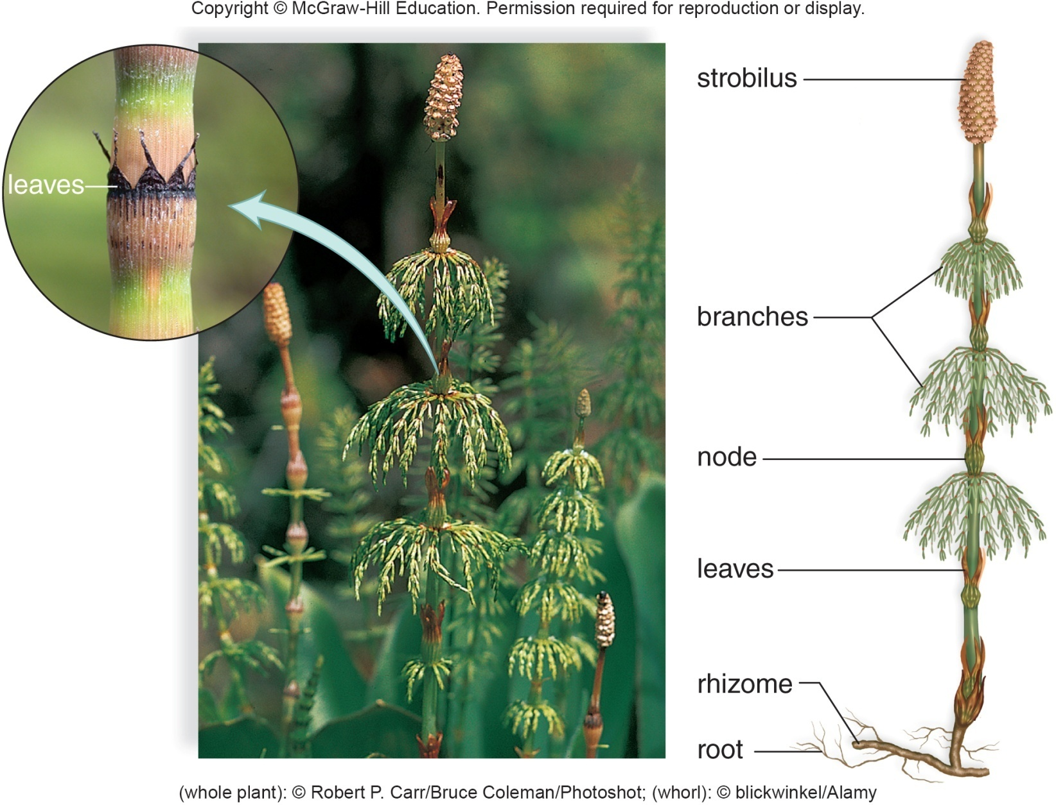
Horsetail, Equisetum
Figure 23.13
Textbook: p. 417 Figure 23.13 | pp. 415-416 Horsetails
(leaves): blickwinkel/Alamy Stock Photo; (plant): Robert Carr/Photoshot

Slide 40
Whisk Ferns
Whisk ferns consist of two genera: Psilotum and Tmesipteris
  Resemble whisk brooms because they have no leaves
  Horizontal rhizome gives rise to aboveground stems that repeatedly fork
  Pumpkin-shaped sporangia are on short side branches
  Tmesipteris species have appendages resembling reduced megaphylls
Textbook: pp. 416-417 Whisk ferns

Slide 41
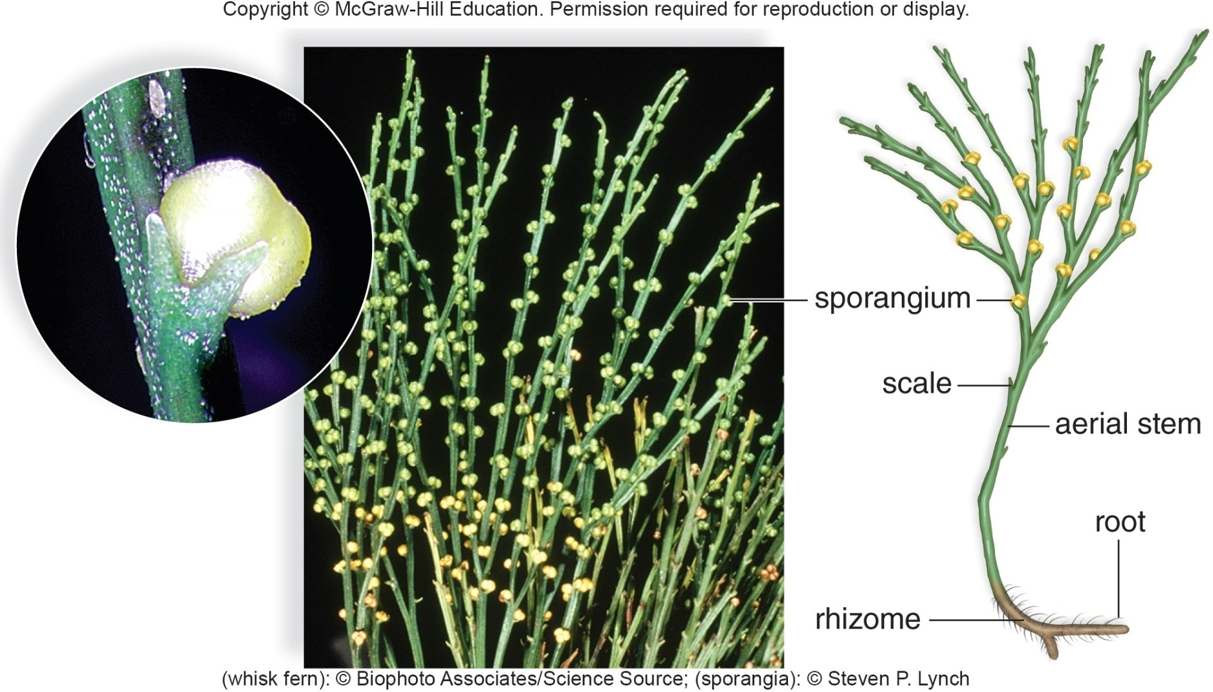
Whisk Fern, Psilotum
Figure 23.14
Textbook: p. 417 Figure 23.14 | pp. 416-417 Whisk ferns
(sporangia): Steven P. Lynch; (plant): Biophoto Associates/Science Source
Notes:
(sporangia): Steven P. Lynch; (plant): Biophoto Associates/Science Source

Slide 42
Ferns
    Approximately 11,000 species
    Most abundant in warm, moist, tropical regions
    Range in size from 1 cm in diameter to 20 m in height
    Large, conspicuous megaphylls are called fronds
      Divided into leaflets
      Sporangia are in clusters called sori on the undersides of fronds
    Dominant sporophyte produces windblown spores by meiosis within sporangia
Textbook: p. 417 Ferns: size, fronds, sori | p. 417 Fern life cycle (text)

Slide 43
Fern Life Cycle
  Windblown spores eventually germinate into gametophytes which produce sperm
  Sperm swim from antheridium to archegonium where fertilization occurs
  When the gametophyte disappears the sporophyte is independent
    Both generations of a fern are considered to be independent of one another
Textbook: p. 417 Fern life cycle (text)

Slide 44
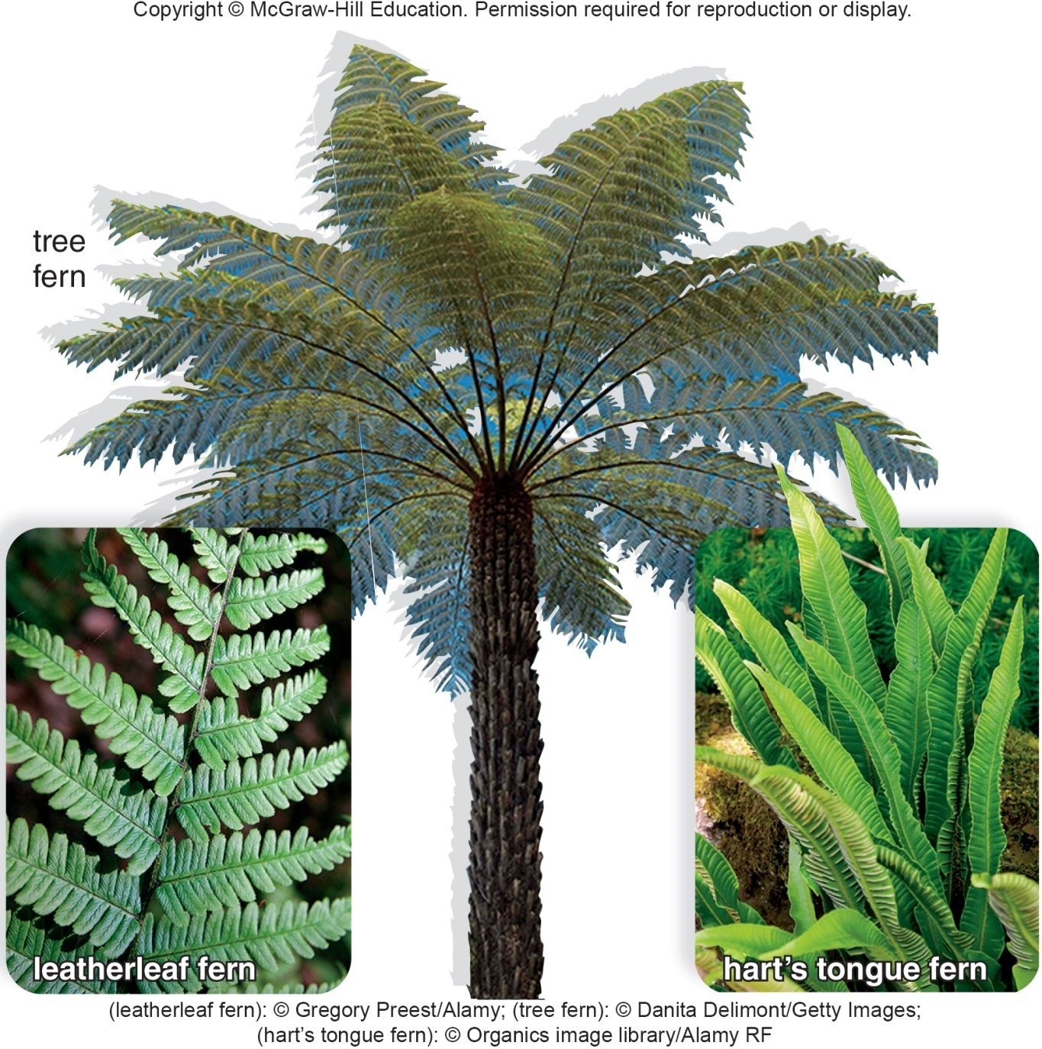
Diversity of Ferns
Figure 23.15
Textbook: p. 417 Figure 23.15 | p. 417 Ferns: size, fronds, sori
(leatherleaf fern): Gregory Preest/Alamy Stock Photo; (tree fern): Danita Delimont/Gallo Images/Getty Images; (hart’s tongue fern): Organics/image library/Alamy Stock Photo

Slide 45
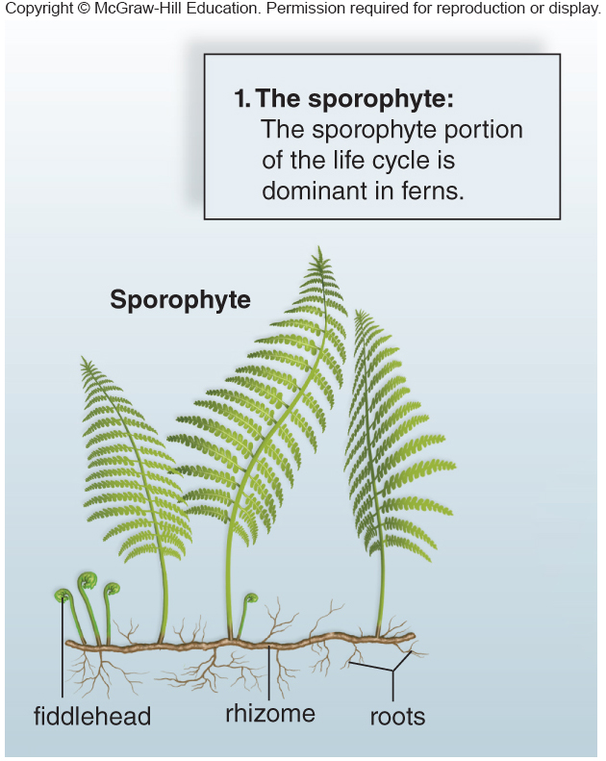
Fern Life Cycle 1
Figure 23.16
Textbook: p. 418 Figure 23.16 | p. 417 Fern life cycle (text)

Slide 46
Fern Life Cycle 2
Figure 23.16
Textbook: p. 418 Figure 23.16 | p. 413 Figure 23.9
Note: this slide's image is actually the MOSS life cycle (Fig. 23.9), not the fern.

Slide 47
Fern Life Cycle 3
Figure 23.16
Textbook: p. 418 Figure 23.16 | p. 413 Figure 23.9
Note: this slide's image is actually the MOSS life cycle (Fig. 23.9), not the fern.

Slide 48
Fern Life Cycle 4
Figure 23.16
Textbook: p. 418 Figure 23.16 | p. 413 Figure 23.9
Note: this slide's image is actually the MOSS life cycle (Fig. 23.9), not the fern.

Slide 49
Fern Life Cycle 5
Figure 23.16
Textbook: p. 418 Figure 23.16 | p. 413 Figure 23.9
Note: this slide's image is actually the MOSS life cycle (Fig. 23.9), not the fern.

Slide 50
Fern Life Cycle 6
Figure 23.16
Access the text alternative for slide images.
Textbook: p. 418 Fig. 23.16 step 5 | p. 418 Figure 23.16 | p. 413 Figure 23.9
Note: this slide's image is actually the MOSS life cycle (Fig. 23.9), not the fern.

Slide 51
Fern Life Cycle 7
Figure 23.16
Access the text alternative for slide images.
Textbook: p. 418 Fig. 23.16 step 6 | p. 418 Figure 23.16 | p. 413 Figure 23.9
Note: this slide's image is actually the MOSS life cycle (Fig. 23.9), not the fern.

Slide 52
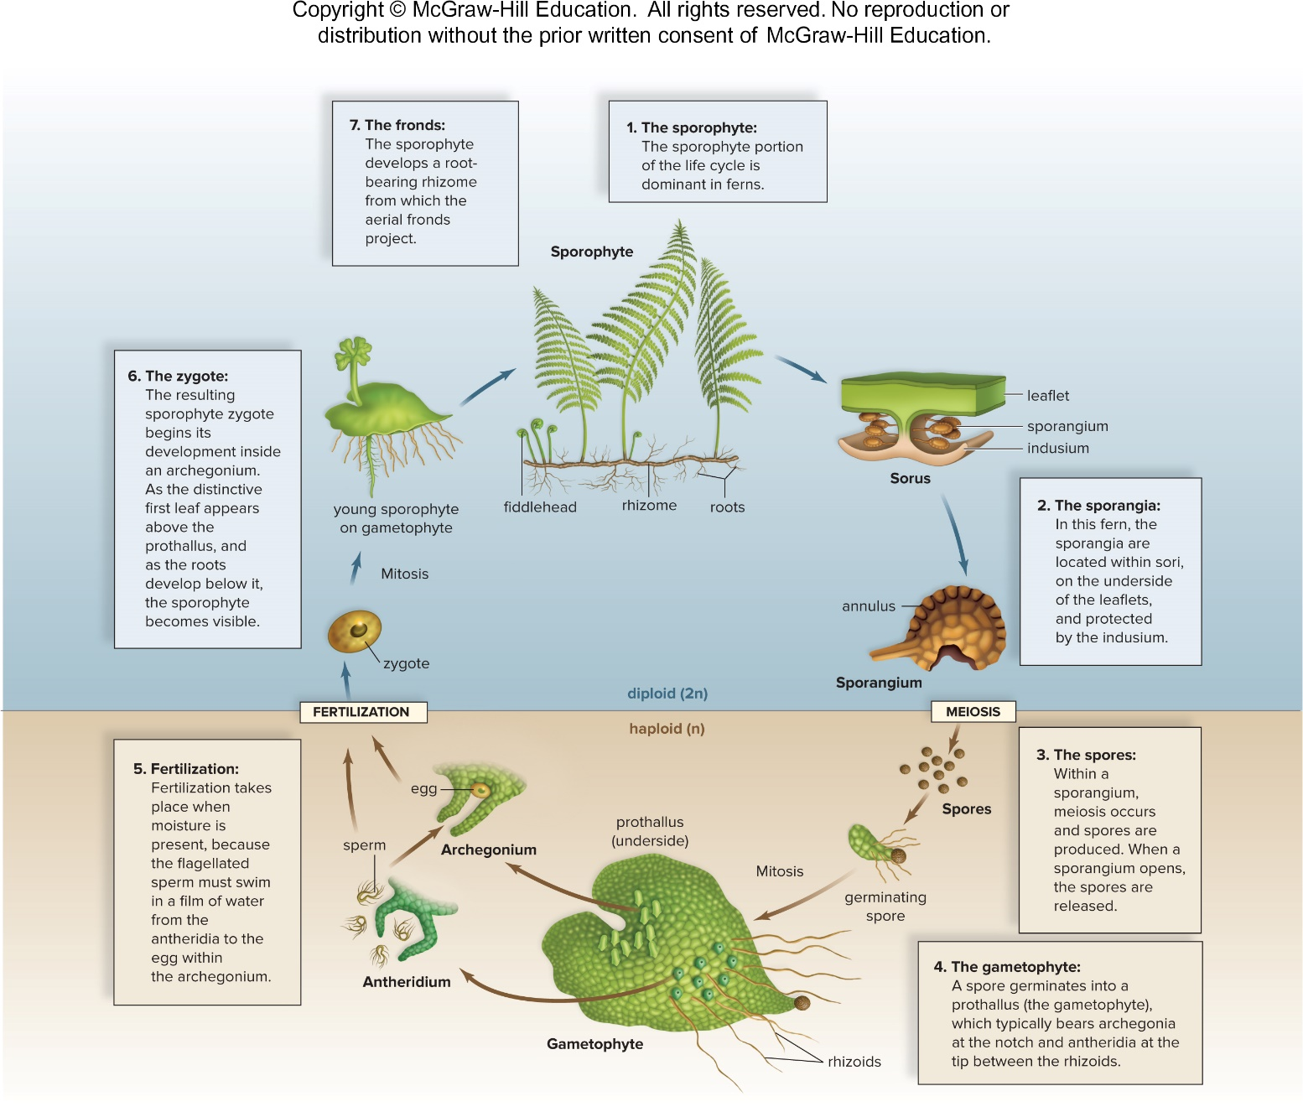
Fern Life Cycle 8
Figure 23.16
Access the text alternative for slide images.
Textbook: p. 418 Figure 23.16 | p. 417 Fern life cycle (text)

Slide 53
The Uses of Ferns
Ferns have economic and medicinal value
  Edible ferns are used as a food source
  Native Americans use them as an astringent during childbirth to stop bleeding
  Maidenhair fern is the source of a cold medicine
  Ferns are frequently used by florists in decorative bouquets and as ornamental plants in the home and garden
  Wood from tropical tree ferns is often used as a building material, because it resists decay, particularly by termites
Textbook: pp. 417-418 Uses of ferns

Slide 54
23.5 Evolution of Seed Plants: Full Adaptation to Land
Seed plants are vascular plants that use seeds during the dispersal phase of their life cycle
  Seeds contain a sporophyte embryo and stored food within a protective seed coat
    Seed coat and stored food allow an embryo to survive harsh conditions during long periods of dormancy (arrested state) until environmental conditions become favorable for growth
    When a seed germinates, the stored food is a source of nutrients for the growing seedling
    Survival of seeds largely accounts for the dominance of seed plants today
Textbook: p. 419 Seeds

Slide 55
Seed Plants
Seed plants are heterosporous (have microspores and megaspores)
Unlike other plant groups, seed plants retain the spores rather than release them into the environment
  Microspores become male gametophytes (pollen grains)
    Pollination occurs when wind or a pollinator carries pollen to the female gametophyte
      Sperm move toward the female gametophyte through a pollen tube
      Megaspore develops into a female gametophyte within an ovule, which becomes a seed following fertilization
      No external water is needed to accomplish fertilization
Textbook: p. 419 Heterospory, pollen, ovules

Slide 56
Gymnosperms and Angiosperms
In gymnosperms (mostly cone-bearing seed plants), the ovules are not completely enclosed by sporophyte tissue at the time of pollination
In angiosperms (flowering plants), the ovules are completely enclosed within diploid sporophyte tissue (ovary), which becomes a fruit.
Textbook: p. 419 Gymnosperms vs. angiosperms

Slide 57
Gymnosperms
    Seeds are not enclosed by fruit—“naked” seeds.
    1,000 species divided into four extant groups:
      Conifers – Most plentiful
      Cycads
      Ginkgoes
      Gnetophytes
Textbook: p. 419 Gymnosperms: 4 groups

Slide 58
Conifers
  About 630 species
    Produce cones
    Tough, needlelike leaves of pines conserve water with a thick cuticle and recessed stomata
    Sporophyte is dominant
    Pollen grains are windblown
    Seed is the dispersal stage
    Monoecious – A single plant produces both pollen (male reproductive structure) and seed cones (female reproductive structure)
Textbook: pp. 419-420 Conifers

Slide 59
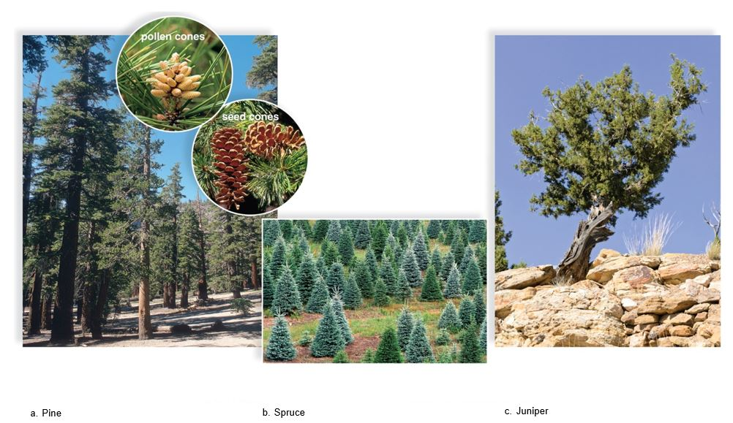
Conifer Examples
Figure 23.17
Textbook: p. 419 Figure 23.17 | pp. 419-420 Conifers
(a): (seed cones): Steven P. Lynch; (pollen cones): Maria Mosolova/Stockbyte/Getty Images; forest): Steven P. Lynch; (b): Ed Reschke/Stone/Getty Images; (c): Steffen Hauser/botanikfoto/Alamy Stock Photo

Slide 60
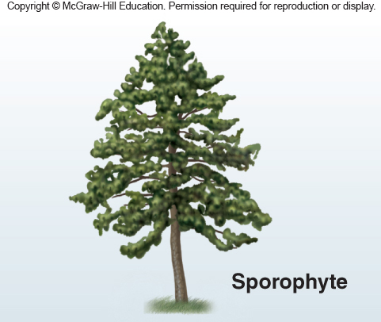
Pine Life Cycle 1
Figure 23.18
Textbook: p. 420 Figure 23.18 | pp. 419-420 Conifers

Slide 61
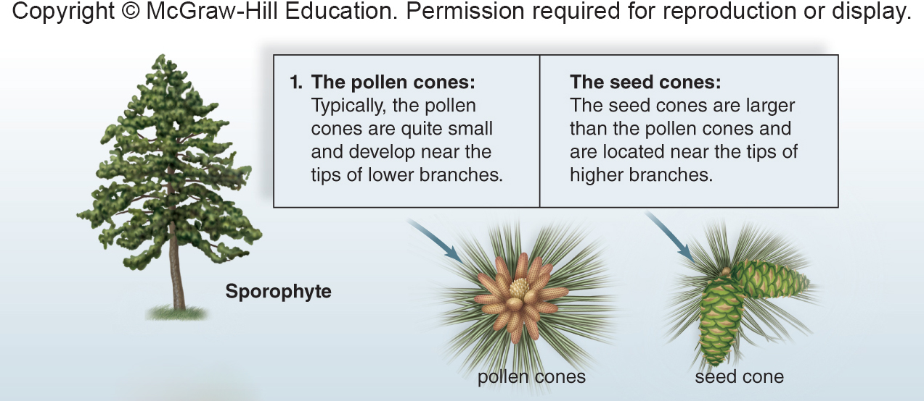
Pine Life Cycle 2
Figure 23.18
Textbook: p. 420 Fig. 23.18 step 1 | p. 420 Figure 23.18

Slide 62
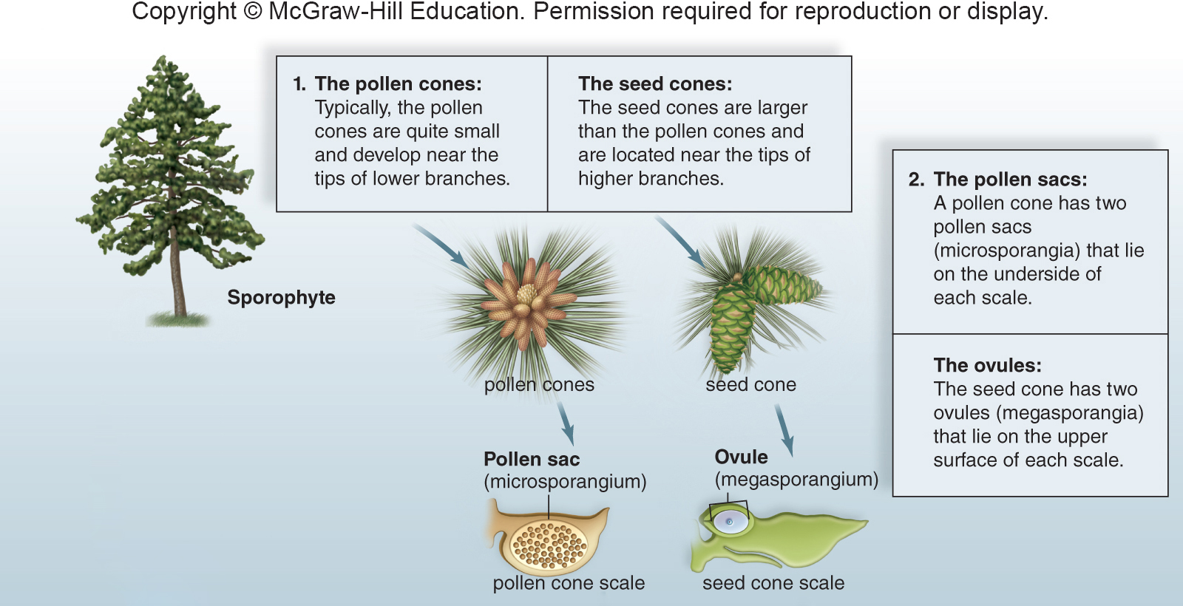
Pine Life Cycle 3
Figure 23.18
Access the text alternative for slide images.
Textbook: p. 420 Fig. 23.18 step 2 | p. 420 Figure 23.18

Slide 63
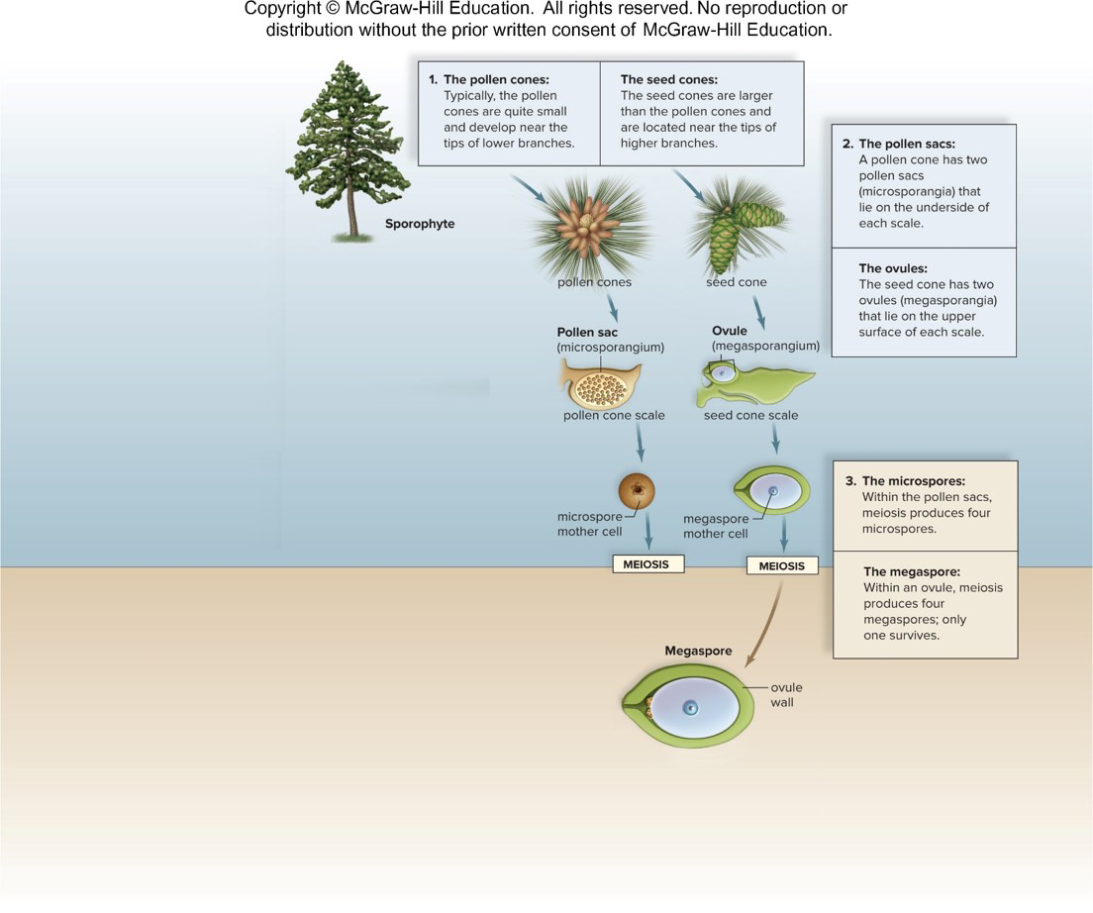
Pine Life Cycle 4
Figure 23.18
Textbook: p. 420 Fig. 23.18 step 3 | p. 420 Figure 23.18

Slide 64
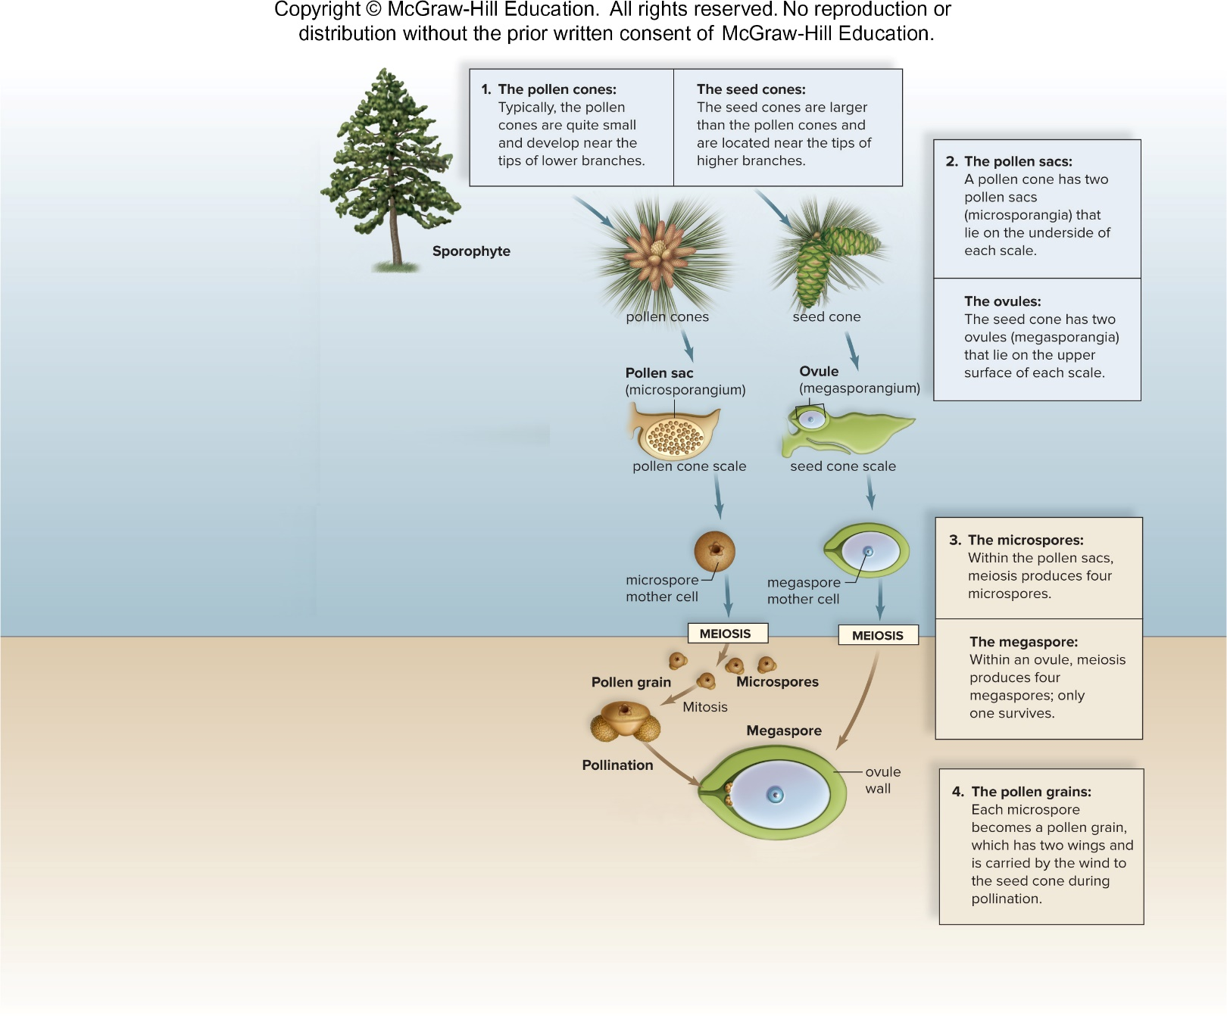
Pine Life Cycle 5
Figure 23.18
Textbook: p. 420 Fig. 23.18 step 4 | p. 420 Figure 23.18

Slide 65
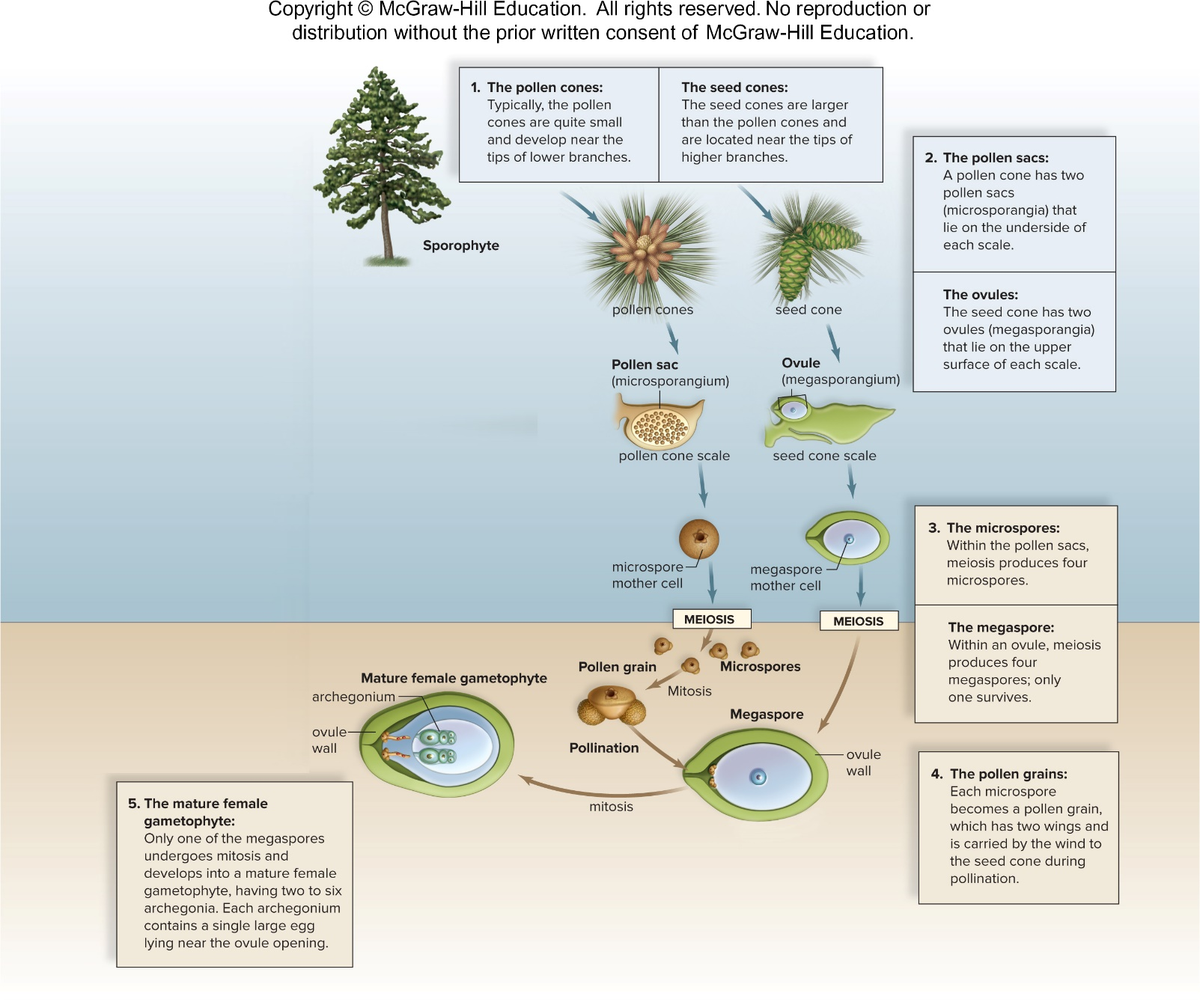
Pine Life Cycle 6
Figure 23.18
Access the text alternative for slide images.
Textbook: p. 420 Fig. 23.18 step 5 | p. 420 Figure 23.18

Slide 66
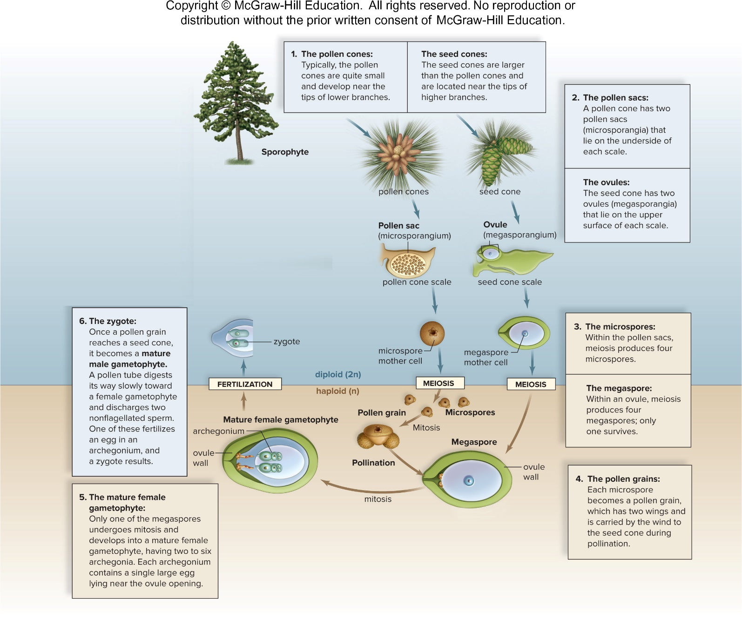
Pine Life Cycle 7
Figure 23.18
Access the text alternative for slide images.
Textbook: p. 420 Fig. 23.18 step 6 | p. 420 Figure 23.18

Slide 67
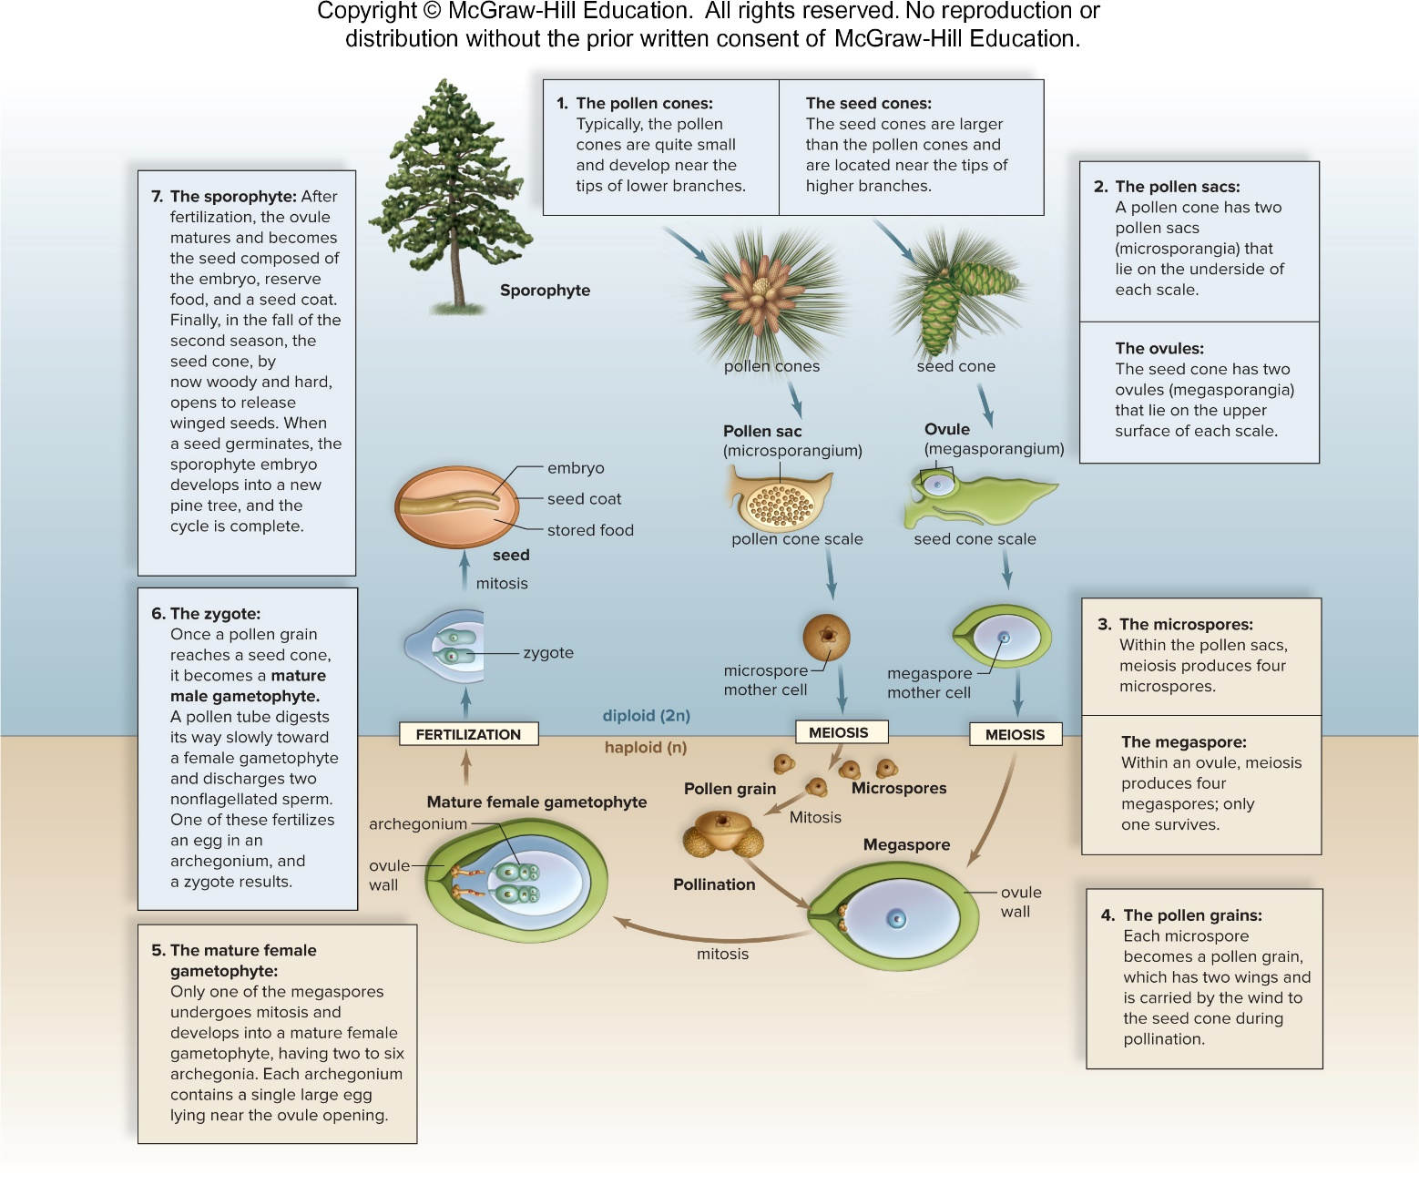
Pine Life Cycle 8
Figure 23.18
Access the text alternative for slide images.
Textbook: p. 420 Fig. 23.18 step 7 | p. 420 Figure 23.18

Slide 68
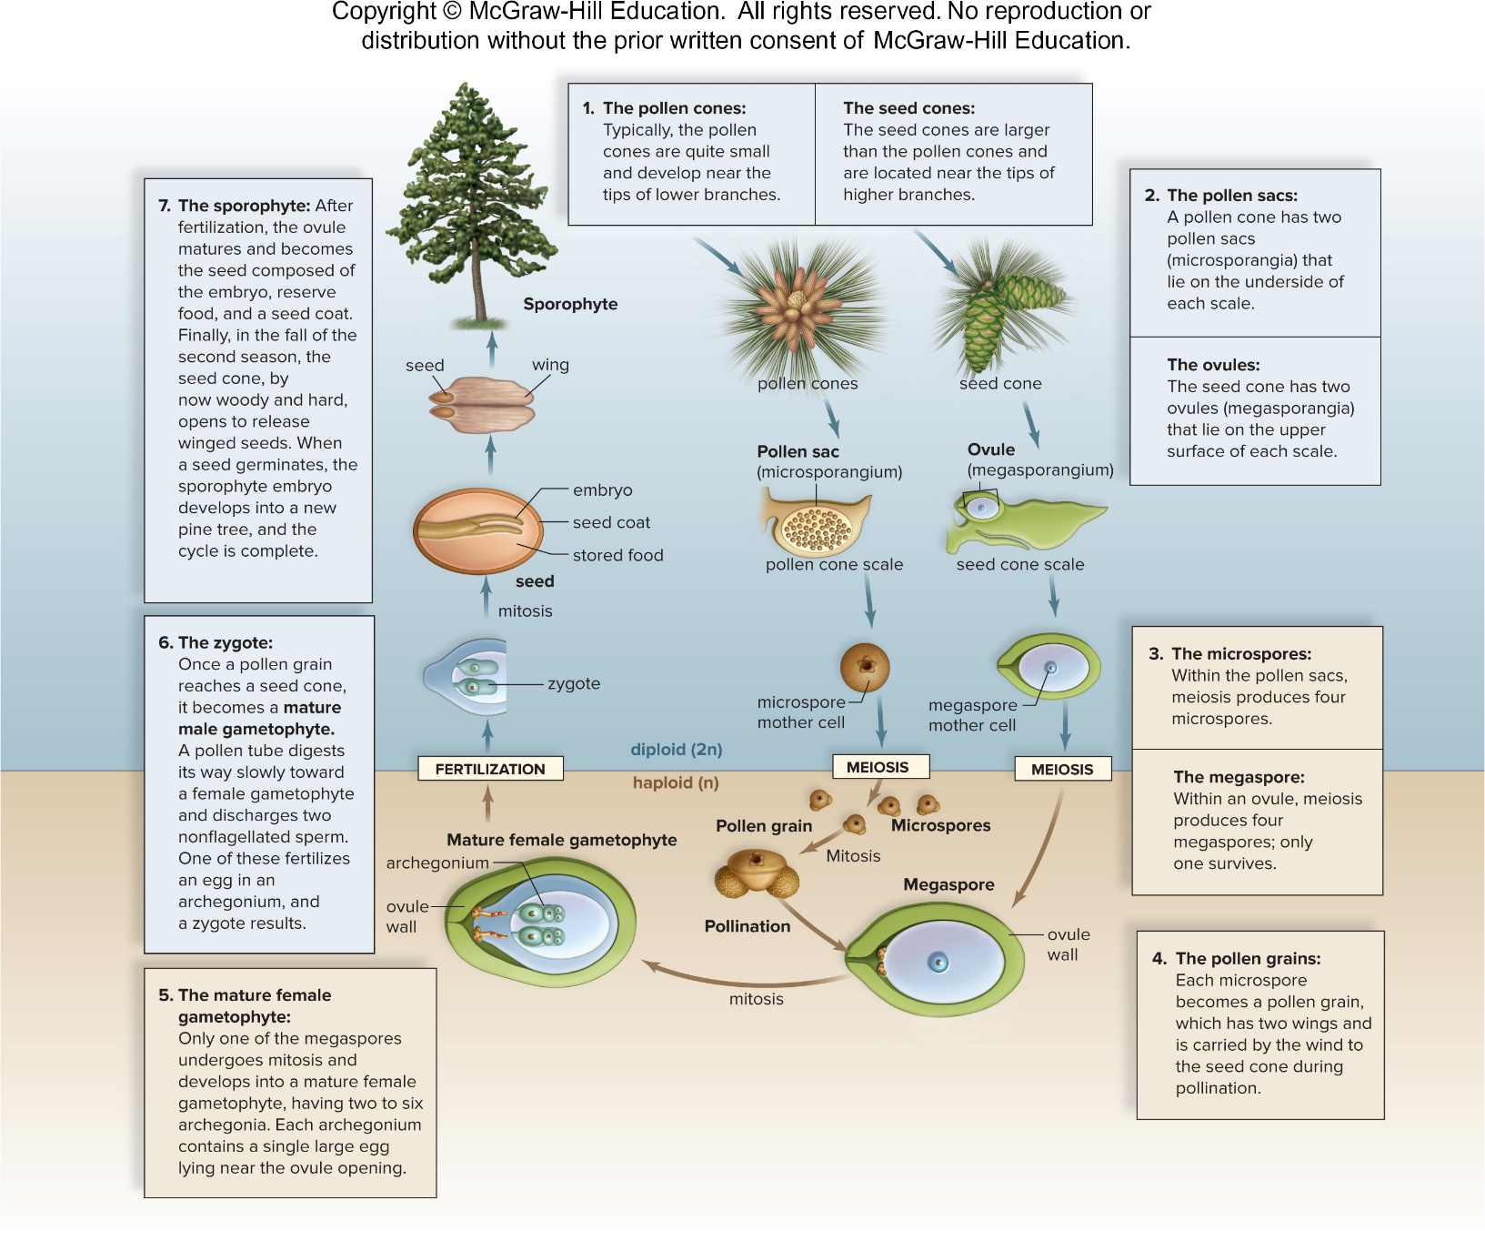
Pine Life Cycle 9
Figure 23.18
Access the text alternative for slide images.
Textbook: p. 420 Figure 23.18 | pp. 419-420 Conifers

Slide 69
Uses of Conifers
Pines are known for their beauty and pleasant smell
  Make attractive additions to parks and gardens
  Have medicinal value
    Needles and bark are rich in vitamins A and C
      Can be used to create teas that ease symptoms of a cold or cough
  Large pine seeds, called pine nuts, are sometimes harvested for use in cooking
  Pine oil is used to scent a number of household and personal care products, such as room sprays and deodorant
Textbook: p. 420 Uses of pines

Slide 70
Cycads
    Include 10 genera and 300 species of distinctive gymnosperms
    Large, finely divided leaves that grow in clusters at the top of the stem
    Cones can be more than 1 m long
    Pollen and seed cones are on separate plants
    Pollinated by insects rather than wind
      Pollen tube bursts near egg and multiflagellated sperm swim to reach an egg
    Plentiful in Mesozoic era at the time of the dinosaurs
      Dinosaurs fed on cycad seeds
Textbook: pp. 420-421 Cycads

Slide 71
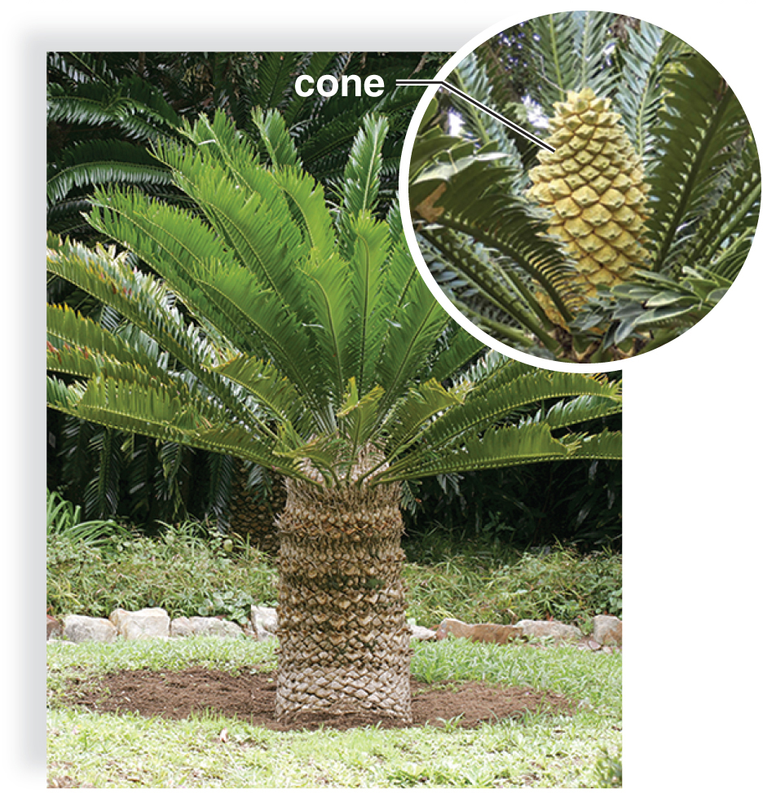
African Cycad
An African cycad
Figure 23.19
Textbook: p. 421 Figure 23.19a | pp. 420-421 Cycads
(a): (cycad): Hoberman Collection/Alamy Stock Photo; (cycad cone): PlazaCameraman/Getty Images

Slide 72
Ginkgoes
One surviving species is Gingko biloba
  Dioecious
    Some trees produce seeds
    Other trees produce pollen
  Trees are resistant to pollution and do well along city streets and in city parks
  Native to China, and in Asia, ginkgo seeds are considered a delicacy
  Extracts have been used to improve blood circulation
  Like cycads, the pollen tube of ginkgo bursts to release multiflagellated sperm that swim to the egg
Textbook: p. 421 Ginkgoes

Slide 73
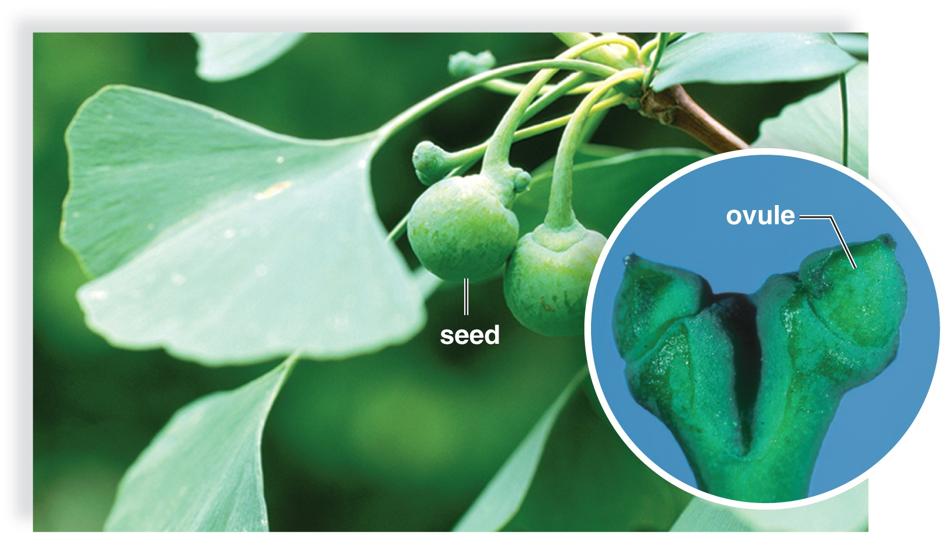
Ginkgo biloba, a Native of China
Ginkgo biloba, a native of China
Figure 23.19
Textbook: p. 421 Figure 23.19b | p. 421 Ginkgoes
(b): (Gingko leaves): blickwinkel/Koenig/Alamy Stock Photo, (ovule): Ken Robertson, University of Illinois/INHS

Slide 74
Gnetophytes
  Three living genera with 65 diverse species
  They have similarly structured xylem
  None have archegonia
  Strobili have similar construction
    Gnetum consists of trees or climbing vines with broad, leathery leaves arranged in pairs
    Ephedrine, a medicine with serious side effects, is extracted from Ephedra
    Welwitschia, found in southwestern Africa, has only two enormous, straplike leaves that fray as it gets older
Textbook: p. 421 Gnetophytes
Textbook says 95 species (slide says 65).

Slide 75
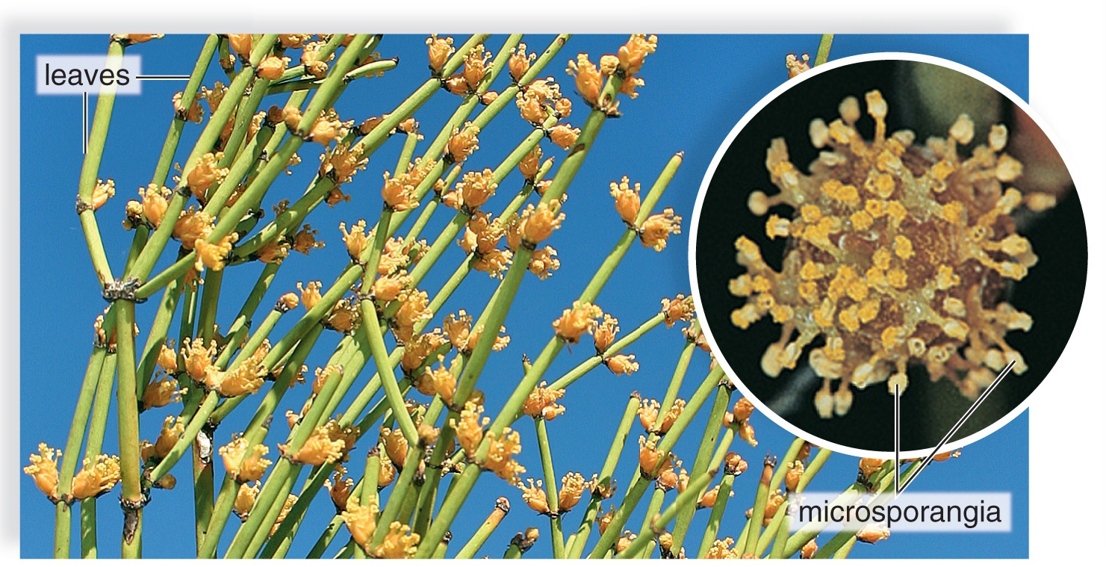
Ephedra, a Type of Gnetophyte
Ephedra, a type of gnetophyte
Figure 23.19
Textbook: p. 421 Figure 23.19c | p. 421 Gnetophytes
(c): (plant): Evelyn Jo Johnson/McGraw-Hill; (microsporangia): Karl J. Niklas

Slide 76
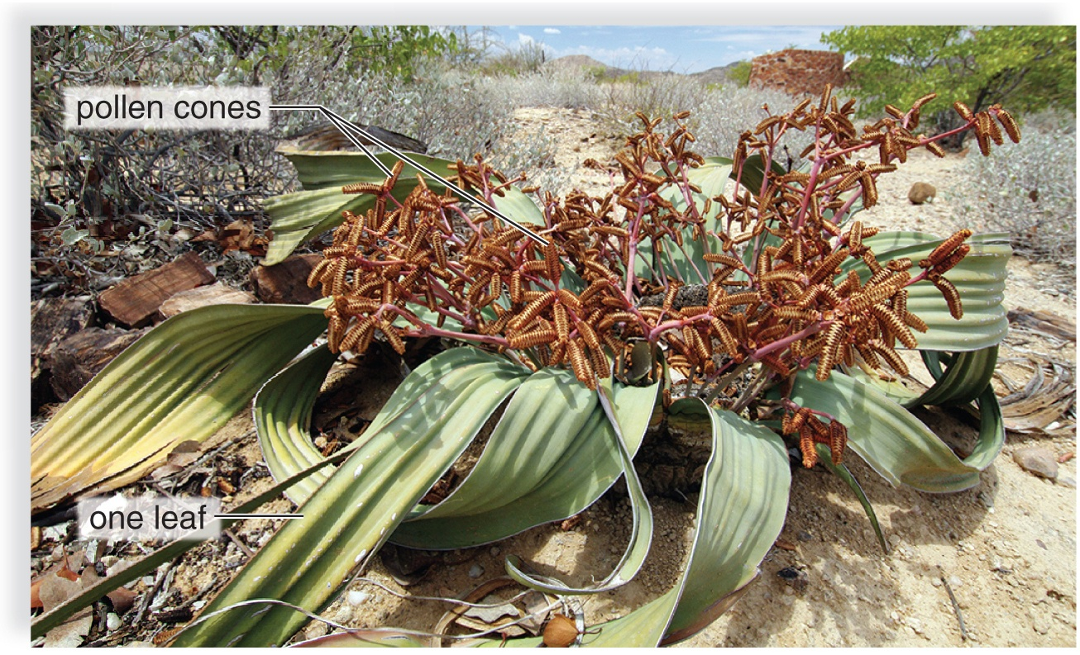
Welwitschia, a Type of Gnetophyte
Welwitschia, a type of gnetophyte
Figure 23.19
Textbook: p. 421 Figure 23.19d | p. 421 Gnetophytes
(d): TravelMuse/Alamy Stock Photo

Slide 77
Angiosperms
    Flowering plants
    Called angiosperms because their ovules are always enclosed within diploid tissues
    Exceptionally large and successful group of plants
      352,000 known species
    Range in size from tiny duckweed to Eucalyptus, over 100 m tall
    All fruits, vegetables, nuts, herbs, and grains, which are the staples of the human diet, are angiosperms
    Provide us with clothing, food, medicines, and other commercially valuable products
Textbook: pp. 421-422 Angiosperms
Textbook says ~370,000 species (slide says 352,000).

Slide 78
Origin and Radiation of Angiosperms
Until recently, the earliest known angiosperm fossil was Archaefructus liaoningensis
  Dates back 135 million years to the Jurassic
  Archaefructus fossil has fruit and flowers
Pollen can be used to date the appearance of a seed plant in an area
  Paleobotanists working in Switzerland discovered 240-million-year-old fossilized pollen from the Triassic
Living angiosperm of today that might be most closely related to the first angiosperms is Amborella
  Lives only on the island of New Caledonia in the South Pacific
  Botanists hope that much may be learned about the early adaptive radiation of angiosperms during the Tertiary period
Textbook: pp. 422-423 Origin & radiation of angiosperms
Textbook (p. 423) names Nanjinganthus (174 mya), not Archaefructus.

Slide 79
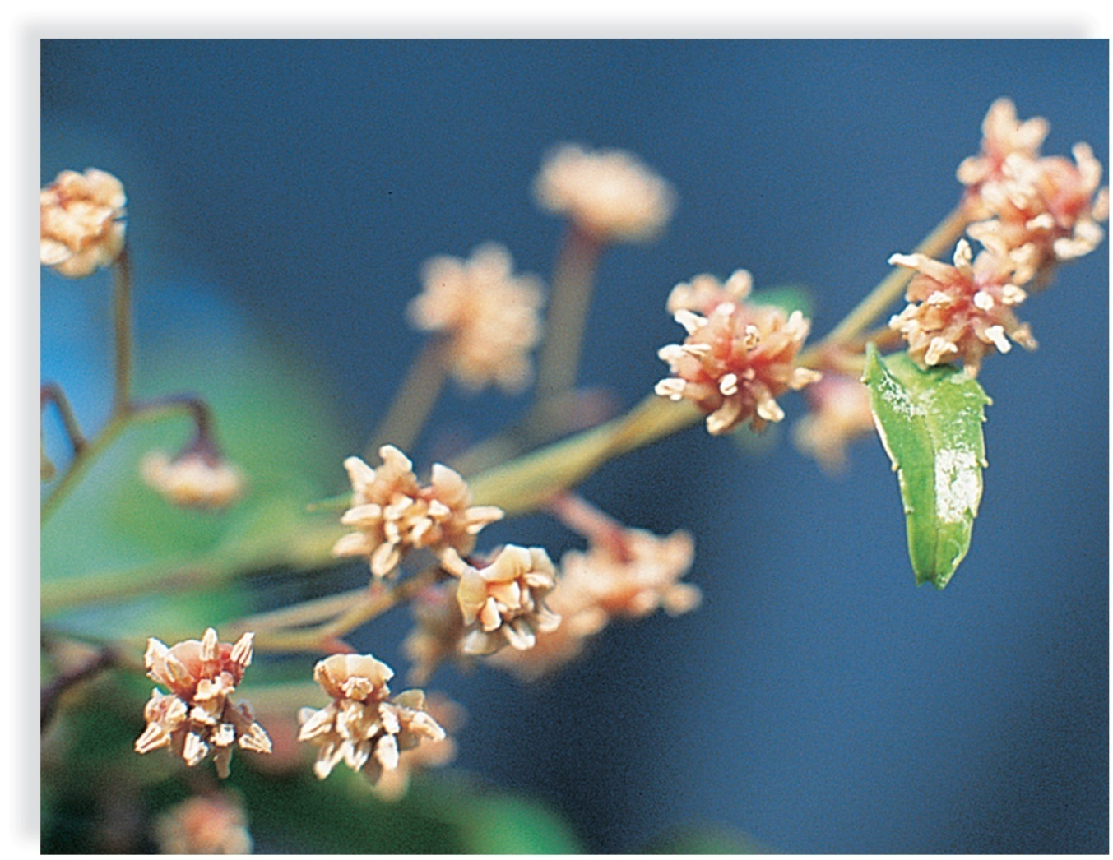
Evolution of Flowering Plants: Amborella trichopoda
Amborella trichopoda
Figure 23.20
Textbook: p. 423 Figure 23.20 | pp. 422-423 Origin & radiation of angiosperms
(b): Stephen McCabe

Slide 80
Monocots and Eudicots
Most flowering plants belong to one of two classes:
  Monocotyledones (monocots)
    Examples include corn, tulips, pineapples, and sugarcane
  Eudicotyledones (eudicots)
    Examples include cacti, strawberries, dandelions, poplars, and beans
Cotyledons are the seed leaves containing nutrients that nourish the embryo
  Monocots: One cotyledon in seed
  Eudicots: Two cotyledons in seed
Textbook: p. 423 Monocots and eudicots

Slide 81
Key Features of Monocots and Eudicots
Table 23.2 Key Features of Monocots and Eudicots
Monocots | Eudicots
One cotyledon | Two cotyledons
Flower parts In threes or multiples of three | Flower parts In fours or fives or multiples of four or five
Pollen grain with one pore | Pollen grain with three pores
Usually herbaceous | Woody or herbaceous
Usually parallel venation | Usually net venation
Scattered bundles In stem | Vascular bundles in a ring
Fibrous root system | Taproot system
Table divided into two columns summarizes key features of monocots and eudicots. The column headers are: Monocots and eudicots.
Textbook: p. 423 Table 23.2 | p. 423 Monocots and eudicots

Slide 82
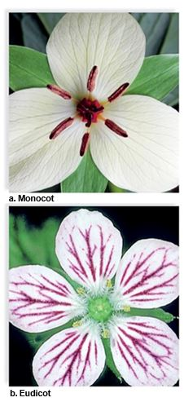
Flower Diversity
Figure 23.21
(a): Ed Reschke/Stone/Getty Images; (b) Steven P. Lynch
Textbook: p. 424 Figure 23.21 | p. 423 The flower: sepals & petals

Slide 83
The Flower
Although flowers vary widely in appearance, most have certain structures in common:
  Sepals are collectively called the calyx
    Protect the flower bud before it opens
    Sepals may drop off or may be colored like the petals
    Usually, however, sepals are green and remain attached to the flower stalk.
  Petals are collectively called the corolla
    Very diverse in size, shape, and color
    Petals are often used to attract a particular pollinator
Textbook: p. 423 The flower: sepals & petals

Slide 84
Parts of Flower
  Stamens are the male structures and consist of two parts:
    Filament: a slender stalk that holds up the anther
    Anther: saclike container that produces pollen
  Carpels are the female structure and are comprised of three major regions:
    Stigma, an enlarged, sticky knob
    Style, a slender stalk
    Ovary, an enlarged base that encloses one or more ovules
      Ovule becomes the seed, and the ovary becomes the fruit. Fruit is often instrumental in the distribution of seeds.
Textbook: pp. 423-424 Stamens & carpels

Slide 85
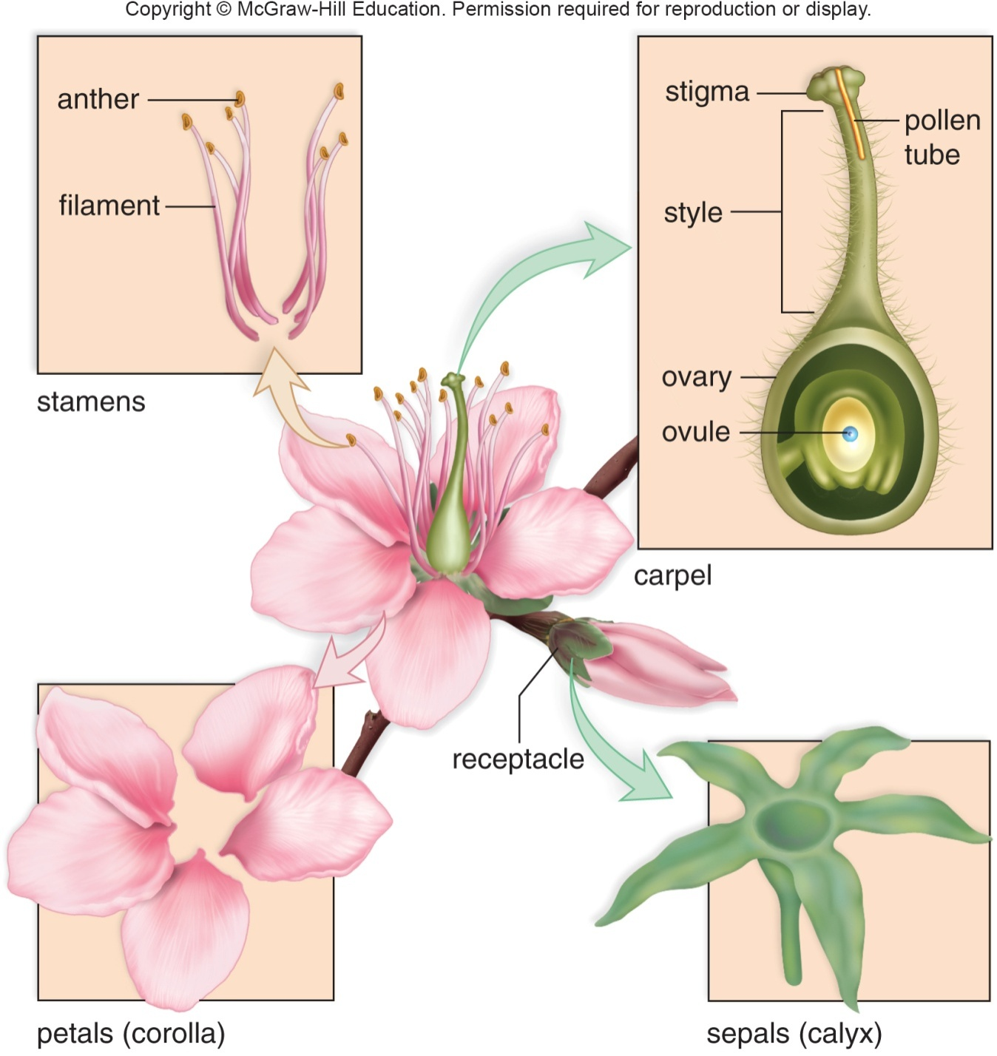
Generalized Flower
Figure 23.22
Textbook: p. 424 Figure 23.22 | p. 423 The flower: sepals & petals | pp. 423-424 Stamens & carpels

Slide 86
Flowering Plant Life Cycle 1
Flowering plants are heterosporous, producing two types of spores:
  Megaspore
    Located in an ovule within an ovary of a carpel
    Develops into an egg-bearing female gametophyte, called the embryo sac
      Usually has seven cells, two have special functions:
        One is an egg
        One contains two polar nuclei
          “Polar” because they come from opposite ends of the embryo sac
Textbook: p. 424 Flowering plant life cycle: megaspore & embryo sac

Slide 87
Flowering Plant Life Cycle 2
  Microspores
    Produced within anthers
    Become pollen grains that, when mature, are male gametophytes with sperm
    Mature male gametophyte consists of only three cells: the tube cell and two sperm cells
During pollination, pollen is transported from the anther to the stigma of a carpel
  Tube cell produces a pollen tube
  Two sperm travel through the tube to the micropyle (small opening) of an ovule
Textbook: pp. 424, 426 Microspores, pollen & pollination

Slide 88
Flowering Plant Life Cycle 3
Flowering plants undergo double fertilization
  One sperm unites with an egg
    Forms a diploid zygote
  Other sperm unites with polar nuclei
    Forms a triploid endosperm nucleus
Ovule becomes a seed
  Contains the embryo (the sporophyte of the next generation)
  Stores food (endosperm) enclosed within a seed coat
Fruit is derived from an ovary
  Some fruits, such as apples provide a moist, fleshy covering
  Other fruits, such acorns, provide a dry covering for seeds
Textbook: p. 426 Double fertilization, seed & fruit

Slide 89
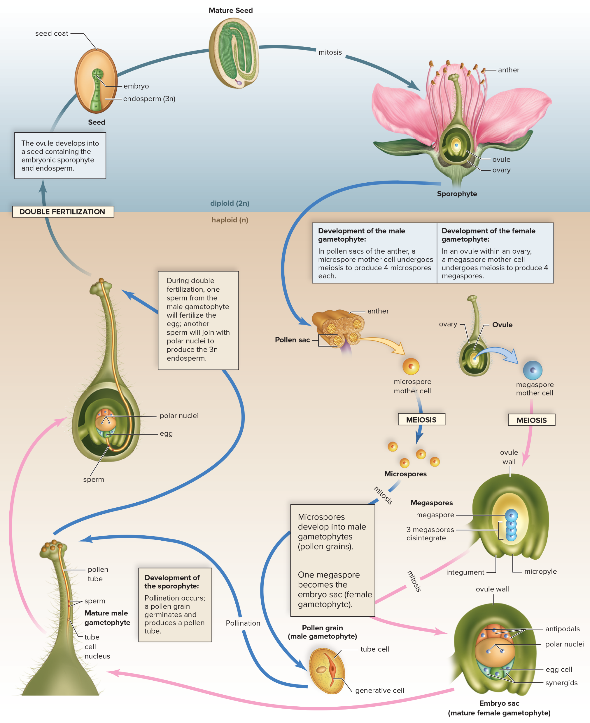
Life Cycle of Flowering Plant
Figure 23.23
Access the text alternative for slide images.
Textbook: p. 425 Figure 23.23 | p. 424 Flowering plant life cycle: megaspore & embryo sac | pp. 424, 426 Microspores, pollen & pollination
p. 426 Double fertilization, seed & fruit

Slide 90
Flowers and Diversification
Various ways pollen and seeds can be dispersed have resulted in many different types of flowers:
  Wind-pollinated flowers are usually not showy
  Bird-pollinated and insect-pollinated flowers are often colorful
  Night-blooming flowers attract nocturnal mammals or insects
      Usually white or cream-colored and aromatic
  Many flowers are adapted to a specific pollinator
  Fruits of flowers protect and aid in seed dispersal
    Utilize wind, gravity, water, and animals for dispersal
Textbook: p. 426 Flowers and diversification

Slide 91
Other Flower Terminology
Table 23.3 Other Flower Terminology
Term | Description of Flower
Complete | All four parts (sepals, petals, stamens, and carpels) present
Incomplete | Lacks one or more of the four parts
Perfect | Has both stamens and (a) carpel(s)
Imperfect | Has stamens or (a) carpel(s), but not both
Inflorescence | A cluster of flowers
Composite | Appears to be a single flower but consists of a group of tiny flowers
Table divided into two columns summarizes other flower terminology. The column headers are: Term and description of flower.
Textbook: p. 424 Table 23.3 | p. 424 Complete vs. incomplete flowers

Slide 92
End of main content
Textbook: p. 427 Chapter summary (What Did You Learn?)
Copyright 2022 © McGraw Hill LLC. All rights reserved. No reproduction or distribution without the prior written consent of McGraw Hill LLC.

Slide 93
Accessibility Content: Text Alternatives for Images
Section divider, no textbook passage. Each text-alternative slide after this one links to its figure.

Slide 94
Evolutionary History of Plants - Text Alternative
Return to parent-slide containing images.
Common green algal ancestor leads to vascular (seed) through flowering plants and gymnosperms.
Common green algal ancestor leads to vascular (seedless) through ferns and allies and lycophytes.
Common green algal ancestor leads to nonvascular (bryophytes) through hornworts, mosses and liverworts.
Common green algal ancestor leads to charophytes.
Return to parent-slide containing images.
Textbook: p. 409 Figure 23.1 | p. 408 Order in which plant groups arose

Slide 95
Embryo Difference in Green Algae and Land Plants - Text Alternative
Return to parent-slide containing images.
A) Microscopic view of embryo of Oedogonium is depicted a tube-like alga with unprotected embryo. B) Microscopic view shows a nourished and protected embryo of Capsella encapsulated in seed.
Return to parent-slide containing images.
Textbook: p. 410 Figure 23.2 | p. 408 Green algae vs. plants; embryo

Slide 96
Leaf Adaptation to Prevent Desiccation
- Text Alternative
Return to parent-slide containing images.
A) Leaves have a waterproof cuticle:
Enlarged diagram shows the presence of white cuticle.
B) Falsely colored scanning electron micrograph of leaf surface:
Micrograph (enlarged 214 times) shows presence of eye shaped stomata across the surface of leaf.
Return to parent-slide containing images.
Textbook: p. 410 Figure 23.4 | pp. 408-409 Adaptation to land: cuticle, stomata, tracheids

Slide 97
Alternation of Generations in Land Plants
- Text Alternative
Return to parent-slide containing images.
In diploid phase, zygote(2n) on mitosis leads to sporophyte (2n), which further leads to sporangium (2).
In haploid phase (n), meiosis leads to spores (n), which on mitosis leads to gametophyte (n). Further, on mitosis, gametes (n) are formed which on fertilization leads to formation of zygote in diploid phase.
Return to parent-slide containing images.
Textbook: p. 410 Figure 23.5 | p. 409 Alternation of generations

Slide 98
Reduction in the Size of the Gametophyte
- Text Alternative
Return to parent-slide containing images.
The data is as follows:
Gametophyte (n):
Moss: rhizoids.
Fern: rhizoids
Gymnosperm: blank
Angiosperm: blank
Sporophytes (2n):
Moss: spores
Fern: spores and roots
Gymnosperm: seed and roots
Angiosperm: seed and roots.
Return to parent-slide containing images.
Textbook: p. 411 Figure 23.6 | pp. 409-410 Dominant generation

Slide 99
Liverwort, Marchantia - Text Alternative
Return to parent-slide containing images.
a) Microscopic view shows thallus present between gemma cup and rhizoids.
b) Male gametophytes bearing antheridia is depicted as sac-like structure of sterile cells.
c) Female gametophyte bearing archegonia is depicted as umbrella shaped structure on top of a stalk.
Return to parent-slide containing images.
Textbook: p. 412 Figure 23.7 | pp. 411-412 Marchantia: rhizoids, gemmae, reproduction

Slide 100
Moss Life Cycle 4 - Text Alternative
Return to parent-slide containing images.
The mature sporophyte has a foot buried in female gametophyte tissue, a stalk, and an upper capsule (the sporangium), where meiosis occurs and spores are produced.
Return to parent-slide containing images.
Textbook: p. 413 Fig. 23.9 step 4 | p. 413 Figure 23.9

Slide 101
Moss Life Cycle 5 - Text Alternative
Return to parent-slide containing images.
When the lid (operculum) of a capsule falls of, the spores are mature. One or two rings of teeth project inward from the margin of the capsule. The teeth close the opening, except when the weather is dry.
Return to parent-slide containing images.
Textbook: p. 413 Fig. 23.9 step 5 | p. 413 Figure 23.9

Slide 102
Moss Life Cycle 8 - Text Alternative
Return to parent-slide containing images.
The details of the moss life cycle between fertilization and meiosis are as follows:
1. The mature gametophytes:
In mosses, the leafy gametophyte shoots bear either antheridia or archegonia, where gametes are produced by mitosis.
2. Fertilization:
Flagellate sperm produced in antheridia swim in external water to archegonia, each bearing a single egg.
3. The zygote:
The zygote and developing sporophyte are retained within the archegonium.
4. The sporophyte:
The mature sporophyte has a foot buried in female gametophyte tissue, a stalk, and an upper capsule (the sporangium), where meiosis occurs and spores are produced.
5. The spores:
When the lid (operculum) of a capsule falls of, the spores are mature. One or two rings of teeth project inward from the margin of the capsule. The teeth close the opening, except when the weather is dry.
6. Spore dispersal:
Spores are released when they are most likely to be dispersed by air currents.
7. The immature gametophyte:
A spore germinates into a male or female protonema, the first stage of the male and the female gametophytes.
Return to parent-slide containing images.
Textbook: p. 413 Figure 23.9 | p. 412 Moss life cycle (text)

Slide 103
Lycophytes Example - Text Alternative
Return to parent-slide containing images.
A) A spike moss, Selaginella.
B) The upper part of club moss consists of strobili (which further consists of sporangia units) and leaves (microphylls), the middle parts consists of branches and the lower part consists of aerial stem, lateral rhizome and root.
Return to parent-slide containing images.
Textbook: p. 414 Figure 23.11 | pp. 414-415 Lycophytes

Slide 104
Microphylls and Megaphylls - Text Alternative
Return to parent-slide containing images.
A) Microphyll:
It consists of a single strand of vascular tissue.
Megaphyll:
It consists of branched vascular tissue.
B) Megaphyll evolution process:
The branched stem system leads to one branch began to dominate the stem system, leading to the side branches flattened into a single plane which further leads to tissue filled in the spaces between the side branches and megaphyll leaf.
Return to parent-slide containing images.
Textbook: p. 415 Figure 23.12 | p. 415 Pteridophytes & megaphylls

Slide 105
Fern Life Cycle 6 - Text Alternative
Return to parent-slide containing images.
Fertilization takes place when moisture is present, because the flagellated sperm must swim in a film of water from the antheridia to the egg within the archegonium.
Return to parent-slide containing images.
Textbook: p. 418 Fig. 23.16 step 5 | p. 418 Figure 23.16

Slide 106
Fern Life Cycle 7 - Text Alternative
Return to parent-slide containing images.
The resulting sporophyte zygote begins its development inside an archegonium. As the distinctive first leaf appears above the prothallus, and the roots develop below it, the sporophyte becomes visible.
Return to parent-slide containing images.
Textbook: p. 418 Fig. 23.16 step 6 | p. 418 Figure 23.16

Slide 107
Fern Life Cycle 8 - Text Alternative
Return to parent-slide containing images.
Details of the fern life cycle are shown. 1. The sporophyte: The sporophyte portion of the life cycle is dominant in ferns. 2. The sporangia: In this fern, the sporangia are located within sori, on the underside of the leaflets, and protected by the indusium. 3. The spores: Within a sporangium, meiosis occurs and spores are produced. When a sporangium opens, the spores are released. 4. The gametophyte: A spore germinates into a prothallus (the gametophyte), which typically bears archegonia at the notch and antheridia at the tip between the rhizoids. 5. Fertilization: Fertilization takes place when moisture is present, because the flagellated sperm must swim in a film of water from the antheridia to the egg within the archegonium. 6. The zygote: The resulting sporophyte zygote begins its development inside an archegonium. As the distinctive first leaf appears above the prothallus, and the roots develop below it, the sporophyte becomes visible. 7. The fronds: The sporophyte develops a root-bearing rhizome from which the aerial fronds project.
Return to parent-slide containing images.
Textbook: p. 418 Figure 23.16 | p. 417 Fern life cycle (text)

Slide 108
Pine Life Cycle 3 - Text Alternative
Return to parent-slide containing images.
The pollen sac: A pollen cone has two pollen sacs (microsporangia) that lie on the underside of each scale. The ovules: The seed cone has two ovules (megasporangia) that lie on the upper surface of each scale.
Return to parent-slide containing images.
Textbook: p. 420 Fig. 23.18 step 2 | p. 420 Figure 23.18

Slide 109
Pine Life Cycle 6 - Text Alternative
Return to parent-slide containing images.
The mature female gametophyte: Only one of the megaspores undergoes mitosis and develops into a mature female gametophyte, having 2 to 6 archegonia. Each archegonium contains a single large egg lying near the ovule.
Return to parent-slide containing images.
Textbook: p. 420 Fig. 23.18 step 5 | p. 420 Figure 23.18

Slide 110
Pine Life Cycle 7 - Text Alternative
Return to parent-slide containing images.
The zygote: Once a pollen grain reaches a seed cone, it becomes a mature male gametophyte. A pollen tube digests its way slowly toward a female gametophyte and discharges two nonflagellated sperm. One of these fertilizes an egg in an archegonium, and a zygote results.
Return to parent-slide containing images.
Textbook: p. 420 Fig. 23.18 step 6 | p. 420 Figure 23.18

Slide 111
Pine Life Cycle 8 - Text Alternative
Return to parent-slide containing images.
The sporophyte: After fertilization, the ovule matures and becomes the seed composed of the embryo, reserve food, and a seed coat. Finally, in the fall of the second season, the seed cone, by now woody and hard, opens to release winged seeds. When a seed germinates, the sporophyte embryo develops into a new pine tree, and the cycle is complete.
Return to parent-slide containing images.
Textbook: p. 420 Fig. 23.18 step 7 | p. 420 Figure 23.18

Slide 112
Pine Life Cycle 9 - Text Alternative
Return to parent-slide containing images.
Details of a typical conifer life cycle are shown. 1. The pollen cones: Typically, the pollen cones are quite small and develop near the tips of lower branches. The seed cones: The seed cones are larger than the pollen cones and are located near the tips of higher branches. 2. The pollen sac: A pollen cone has two pollen sacs (microsporangia) that lie on the underside of each scale. The ovules: The seed cone has two ovules (megasporangia) that lie on the upper surface of each scale. 3. The microspores: Within the pollen sacs, meiosis produces four microspores. The megaspore: Within an ovule, meiosis produces four megaspores; only one survives. 4. The pollen grains: Each microspore becomes a pollen grain, which has two wings and is carried by the wind to the seed cone during pollination. 5. The mature female gametophyte: Only one of the megaspores undergoes mitosis and develops into a mature female gametophyte, having two to six archegonia. Each archegonium contains a single large egg lying near the ovule. 6. The zygote: Once a pollen grain reaches a seed cone, it becomes a mature male gametophyte. A pollen tube digests its way slowly toward a female gametophyte and discharges two nonflagellated sperm. One of these fertilizes an egg in an archegonium, and a zygote results. 7. The sporophyte: After fertilization, the ovule matures and becomes the seed composed of the embryo, reserve food, and a seed coat. Finally, in the fall of the second season, the seed cone, by now woody and hard, opens to release winged seeds. When a seed germinates, the sporophyte embryo develops into a new pine tree, and the cycle is complete.
Return to parent-slide containing images.
Textbook: p. 420 Figure 23.18 | pp. 419-420 Conifers

Slide 113
Flower Diversity - Text Alternative
Return to parent-slide containing images.
Regardless of size and shape, flowers, such as this
monocot, and
eudicot, share certain features.
Return to parent-slide containing images.
Textbook: p. 424 Figure 23.21

Slide 114
Life Cycle of Flowering Plant - Text Alternative
Return to parent-slide containing images.
Details of a typical flowering plant cycle are shown.1. The stamen: An anther at the top of a stamen has four pollen sacs. Pollen grains are produced in pollen sacs. The carpel: The ovary at the base of a carpel contains one or more ovules. The contents of an ovule change during the flowering plant lifecycle. 2. The pollen sacs: In pollen sacs (microsporangia) of the anther, meiosis produces microspores. The ovules: In an ovule (megasporangium) within an ovary, meiosis produces four megaspores. 3. The microspores: Each microspore in a pollen sac undergoes mitosis to become an immature pollen grain with two cells: the tube cell and the generative cell. The pollen sacs open, and the pollen grains are windblown or transported by an animal carrier, usually to other flowers. This is known as pollination. The megaspores: Inside the ovules of an ovary, three megaspores disintegrate, and only the remaining one undergoes mitosis to become a female gametophyte. 4. The mature male gametophyte: A pollen grain that lands on the carpel of the same type of plant germinates and produces a pollen tube, which grows within the style until it reaches an ovule in the ovary. Inside the pollen tube, the generative cell nucleus divides and produces two nonflagellated sperm. A fully germinated pollen grain is the mature male gametophyte. The mature female gametophyte: The ovule now contains the mature female gametophyte (embryo sac), which typically consists of eight haploid nuclei embedded in a mass of cytoplasm. The cytoplasm differentiates into cells, one of which is an egg and another that contains two polar nuclei. 5. Double fertilization: On reaching the ovule, the pollen tube discharges the sperm. One of the two sperm migrates to and fertilizes the egg, forming a zygote; the other unites with the two polar nuclei, producing a 3n (triploid) endosperm nucleus. The endosperm nucleus divides to form endosperm, food for the developing embryo. 6. The seed: The ovule now develops into the seed, which contains an embryo and food enclosed by a protective seed coat. The wall of the ovary and sometimes adjacent parts develop into a fruit that surrounds the seed(s). 7. The sporophyte: The embryo within a seed is the immature sporophyte. When a seed germinates, growth and differentiation produce the mature sporophyte of a flowering plant.
Return to parent-slide containing images.
Textbook: p. 425 Figure 23.23 | p. 424 Flowering plant life cycle: megaspore & embryo sac | pp. 424, 426 Microspores, pollen & pollination
p. 426 Double fertilization, seed & fruit

